Slide 1

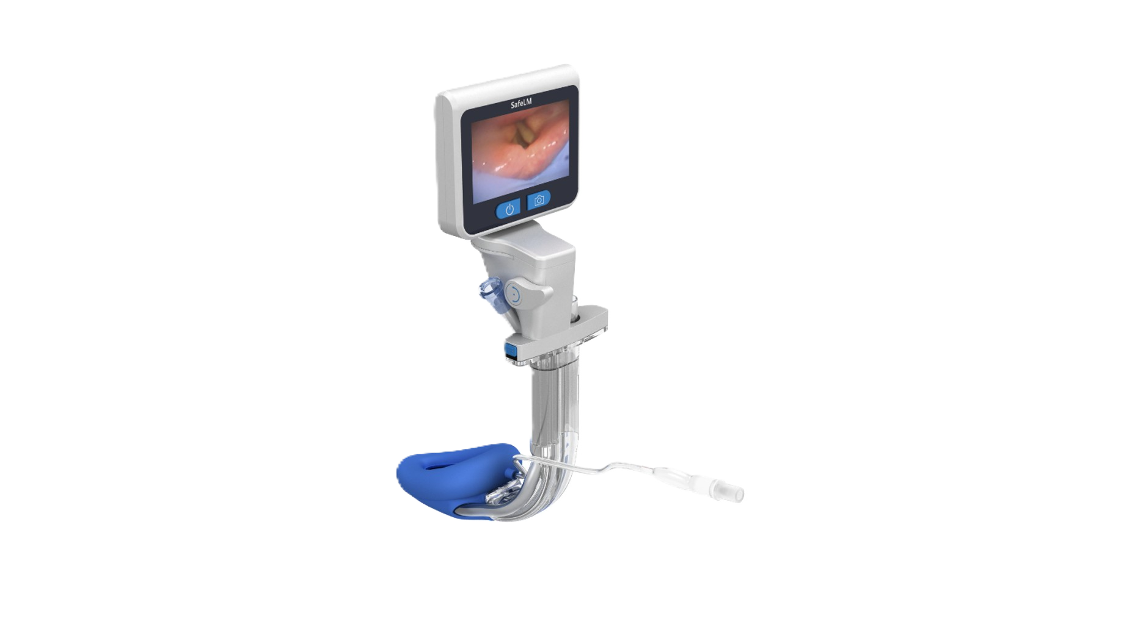

SAFELM
VIDEO LARYNGEAL MASK
Magill Medical Technology
The only third generation supraglottic airway device
with an adjustable viewing angle
WWW.MAGILLMED.COM
Slide adaption from Tim Hoo

Slide 2

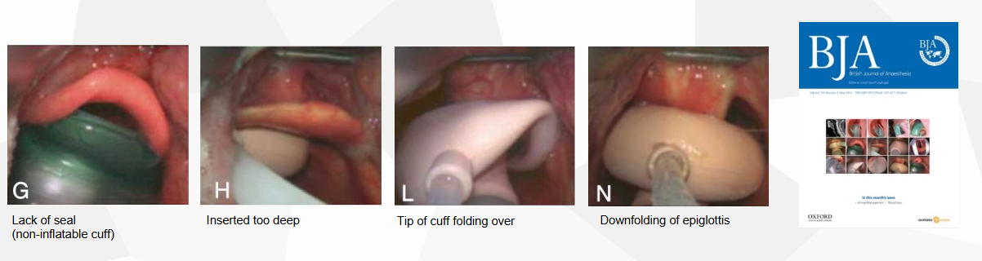
Malposition
1
Malposition occurs in 50-80% of blind placement​ (BJA 2016, Van Zundert)
LIMITATIONS OF A CONVENTIONAL SGA
2
Air Leak
Higher risk of air leak due to malposition and limited OLP, especially during positive pressure ventilation
3
Aspiration Risk
Risk of gastric insufflation and regurgitation, leading to aspiration, especially in laparoscopic surgery or obese patients/existing reflux disease.
Traditional supraglottic airway devices (1st and 2nd generation) are inserted blindly, which can lead to some clinical problems.
4
Intra-operative displacement
SGAs can potentially migrate or displace during surgery, depending on the nature of the surgery or change in positioning etc.
As a result, ETTs are still preferred for many advanced surgeries

Slide 3
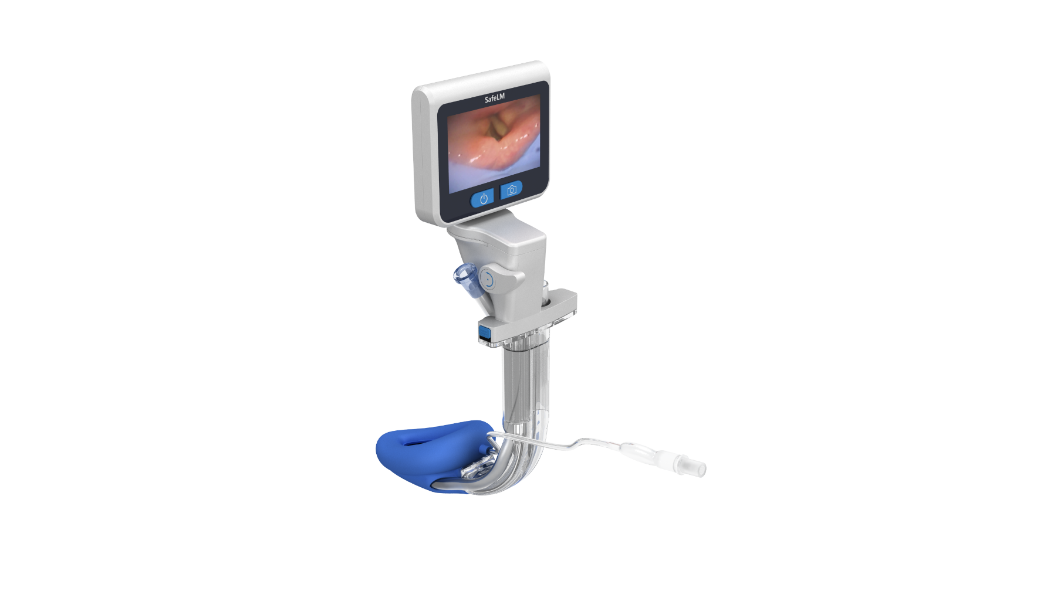
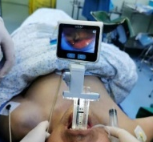
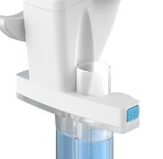
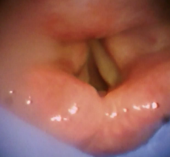
NEED FOR A VIDEO LARYNGEAL MASK
A video guided SGA allows for direct visualization and monitoring of airway anatomy.
1
Airway &
Intubation Channel
Real time confirmation of mask position
LCD Screen
2
Immediate correction of mask position
Power, Image Capture
Camera Adjusting Handle
3
Continuous monitoring of airway
intra-operatively
Gastric Channel
Videoscope Release Button
>180° viewing angle
Ensure clear view to glottis
4
Improved ventilation safety and aspiration risk reduction
Airway Channel
Gastric Channel
Video Channel

Slide 4
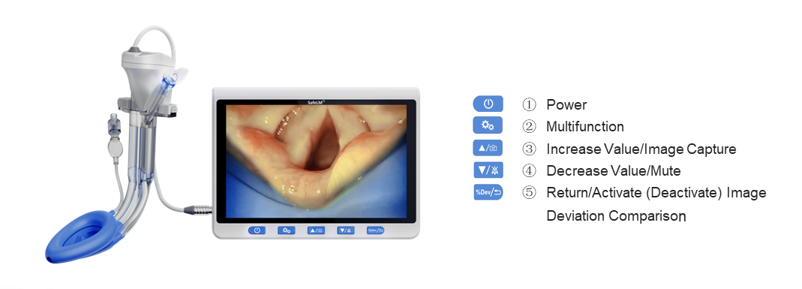
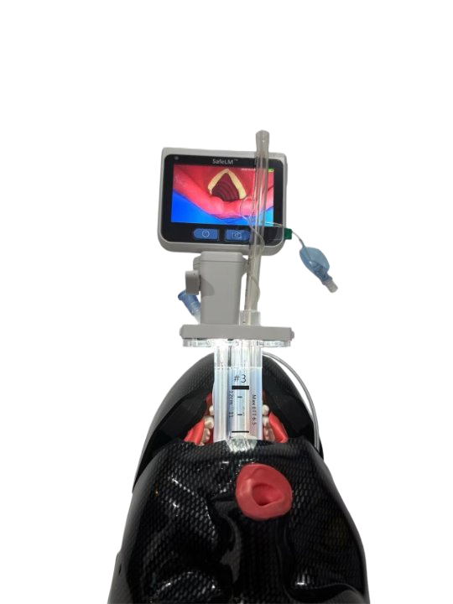
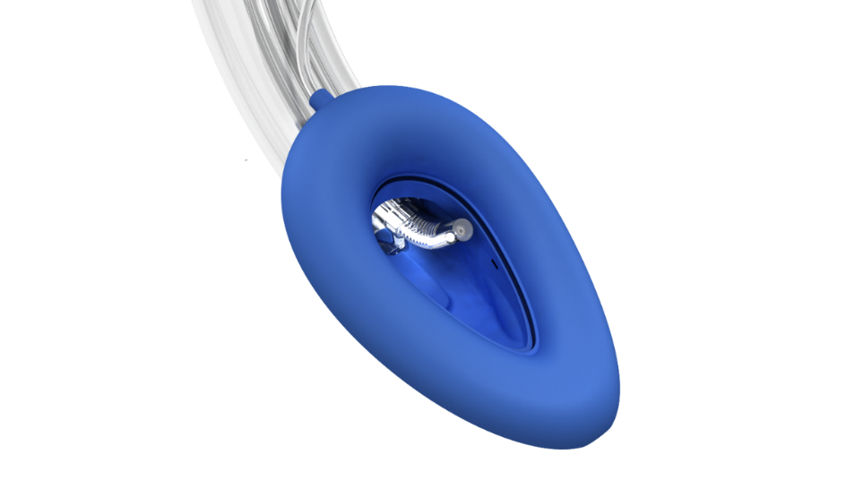
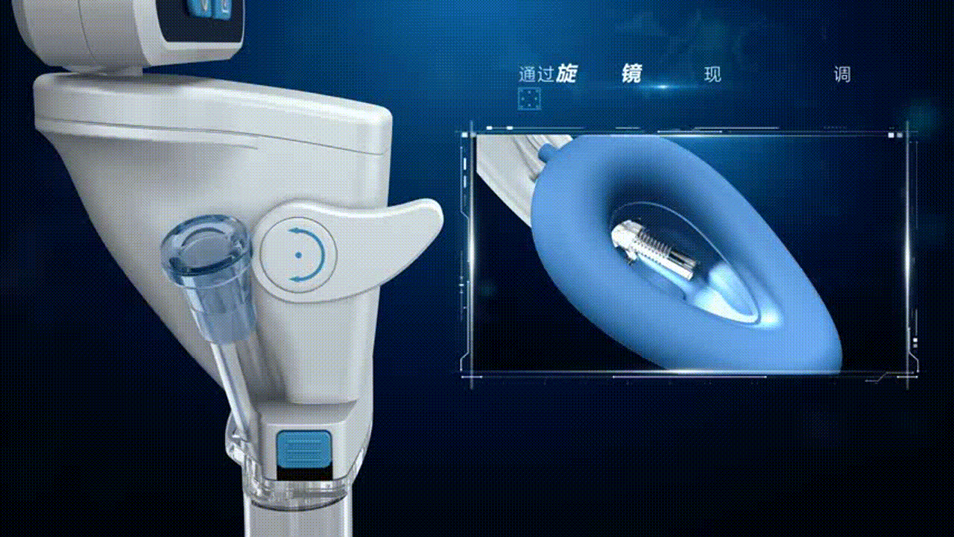
SAFELM TECHNOLOGY
Key Features
Adjustable camera tip
Continuous airway visualization with deviation alarm
High oropharyngeal leak pressure (35-40 cmH₂O)
Gastric drainage channel
Intubation conduit
Auto-recording and photo taking capability
This allows both ventilation and visualization

Slide 5
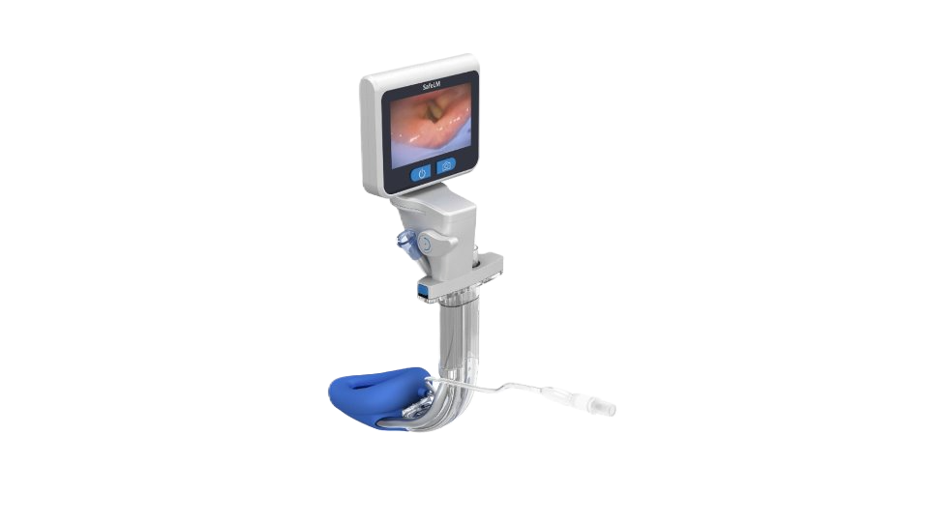
SAFELM VS CONVENTIONAL SGA
Feature | Traditional LMA | Endotracheal Tube | SafeLM
Insertion | Blind | Laryngoscopy | Video-guided
Airway visualization | No | Yes | Yes
Seal pressure | Moderate | High | High
Continuous airway monitoring | No | No | Yes
Intubation capability | Depend on gen | Primary method | Yes
SafeLM combines advantages of both LMA and ETT while reducing their limitations.​

Slide 6
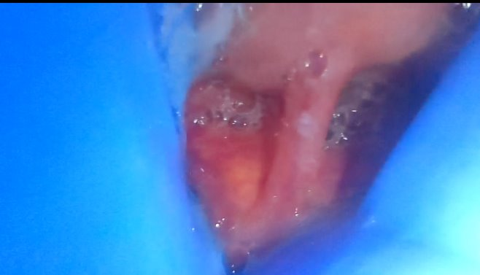
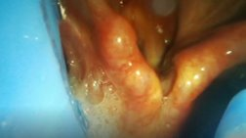
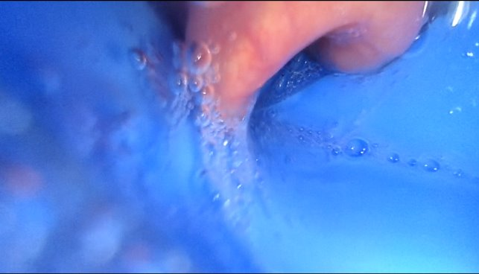
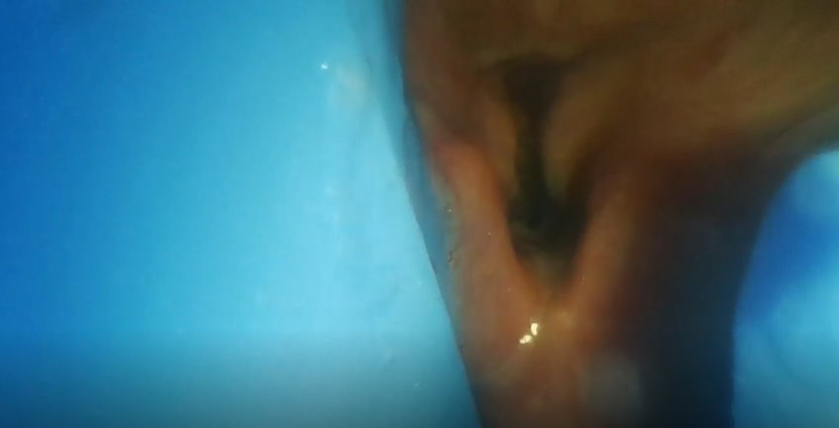
IMPORTANCE OF OPTIMAL DEPTH
Ensuring optimal position
prevents air leak
reduces gastric regurgitation/aspiration risk
guides repositioning if required
gives confidence on expanded uses for an SGA

Slide 7
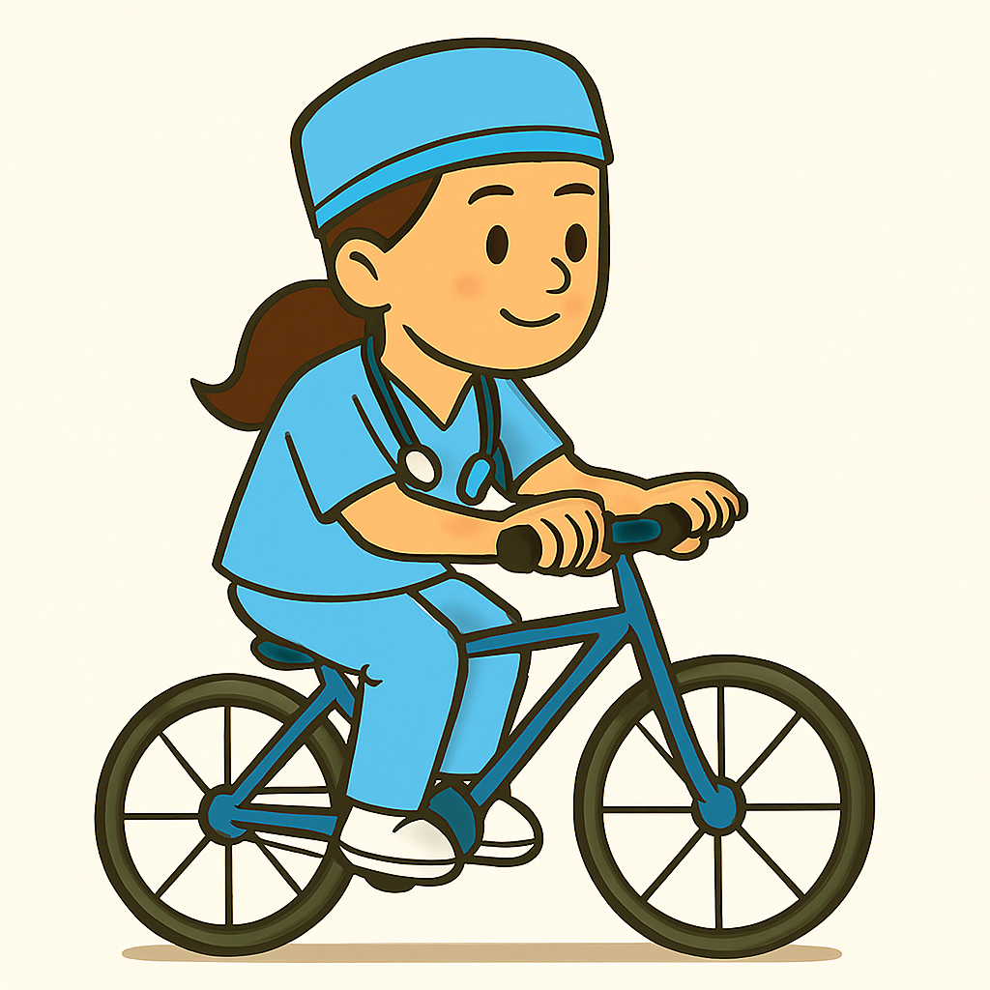
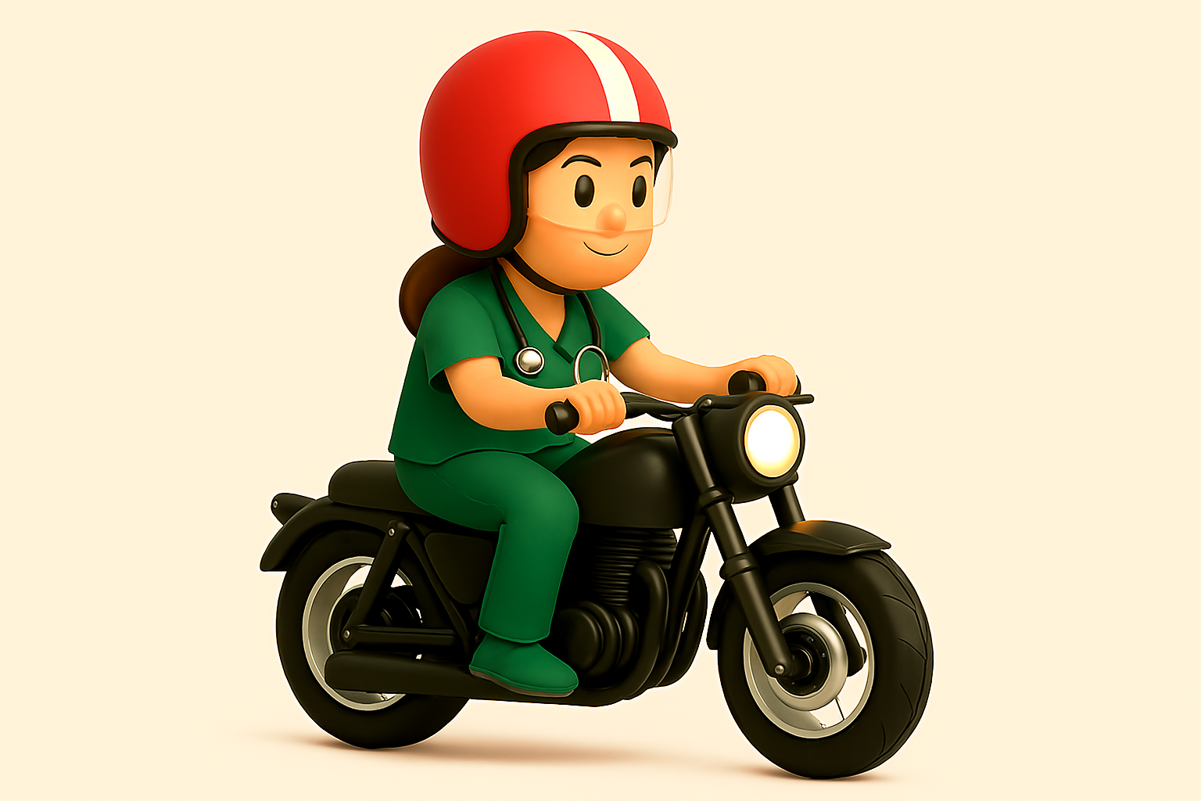
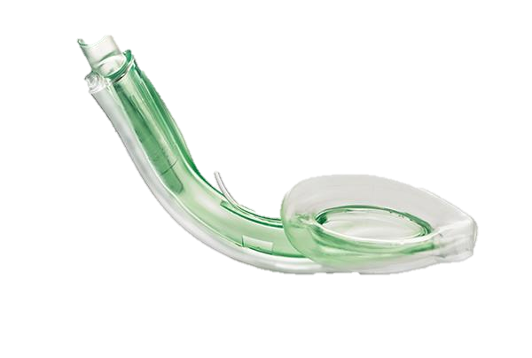
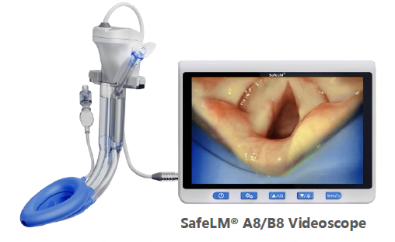
Basic SGA Indications
Advanced SGA Indications
Surgery <2h
Supine position
Non-laparoscopic surgery
Non-overweight patients
Surgery >2h or unpredictable duration
Lateral and other positions
Laparoscopic surgery
Overweight patients
Tubeless thoracic surgery
Difficult airway
ASA 3 and 4 patients

Slide 8
HOW SAFELM CAN ENABLE ADVANCED INDICATIONS
SafeLM solves the main limitations of a conventional SGA
Limitation | SafeLM Solution
Blind insertion | Real-time video guidance
Mask displacement | Continuous airway monitoring
Poor seal | High OLP (35-40 cmH2O)
Aspiration risk | Gastric drainage + visualization
SafeLM can now be safely used for more complex procedures not previously supported by conventional SGAs

Slide 9
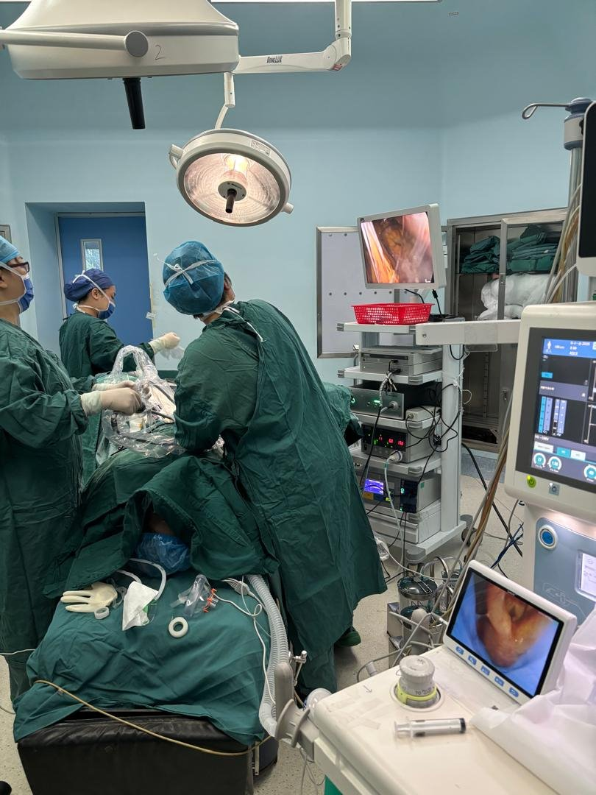
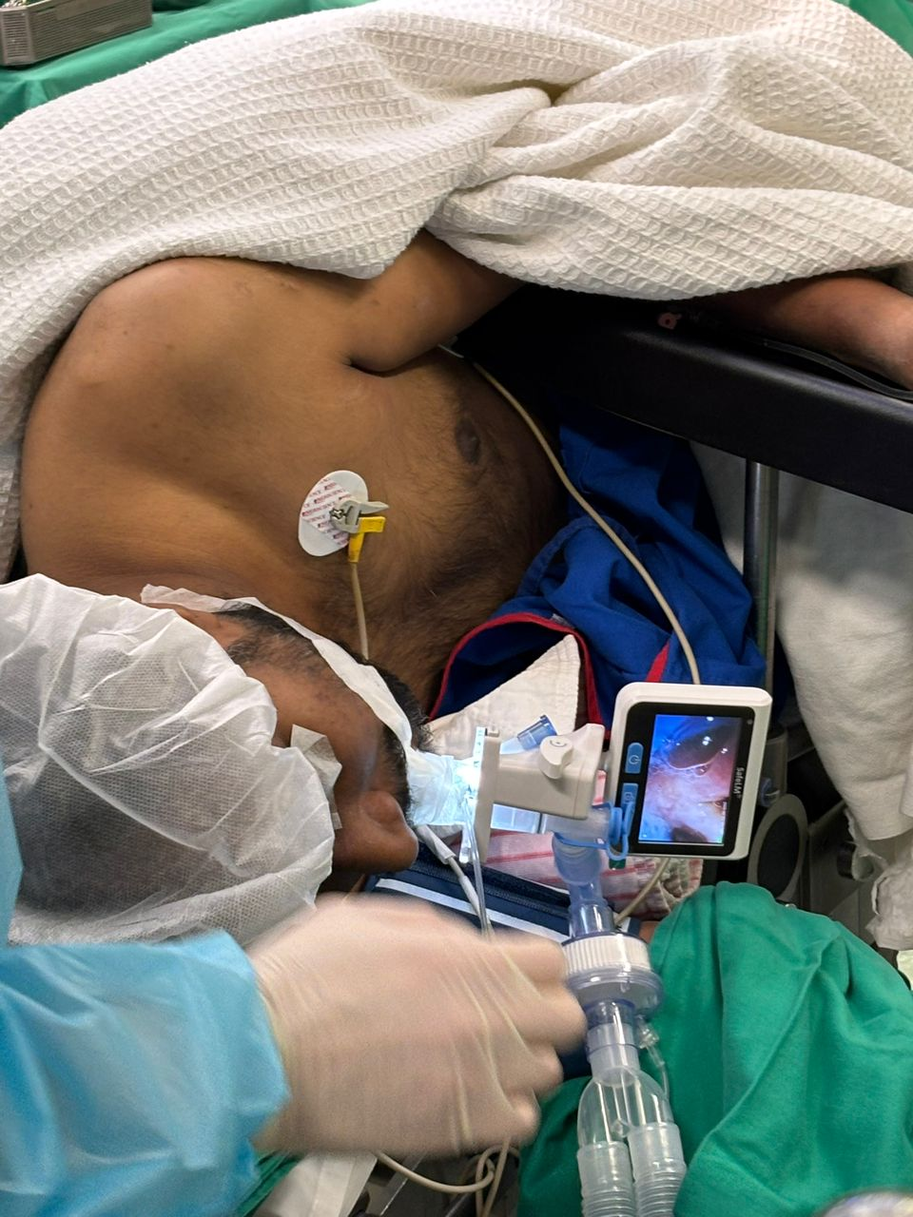
ADVANCED SURGICAL APPLICATIONS
SafeLM can support SGA use in situations traditionally managed with ETT:
Laparoscopic / robotic surgery
Tubeless thoracic surgery
Procedures > 2 hours
Non-supine surgery
Lateral
Trendelenburg
Prone
Overweight patients
Laparoscopic surgery in China
2025
Lateral position surgery in Malaysia 2025

Slide 10
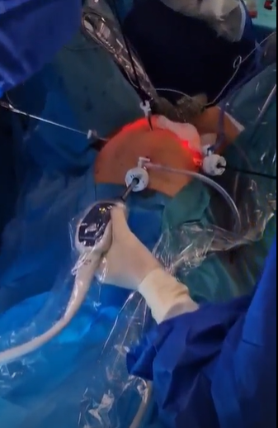
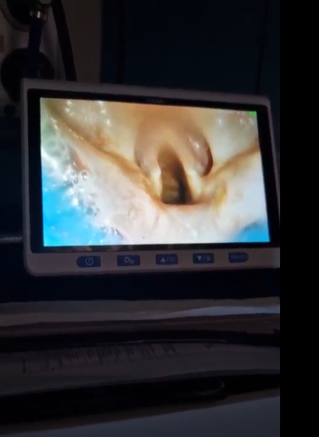
EXAMPLE: LAPAROSCOPIC SURGERY
SafeLM can address the main airway management concerns in laparoscopy
Challenges in laparoscopy:
Pneumoperitoneum increases ventilation pressure
Risk of gastric insufflation
Trendelenburg positioning
SafeLM advantages:
High airway seal pressure (35-40cm H2O)
Continuous visualization of airway
Monitoring for regurgitation / secretion
Medicover Hospital, Warsaw, Poland
October 2025
Planned 3h laparoscopic gynecological procedure, complicated by endometriosis laser ablation and unplanned bowel resection, total 7h in Trendelenberg. No aspiration, secretions continuously monitored under direct visualization
Clinical experience shows SafeLM can maintain safe ventilation even in long laparoscopic procedures in Trendelenberg position.

Slide 11
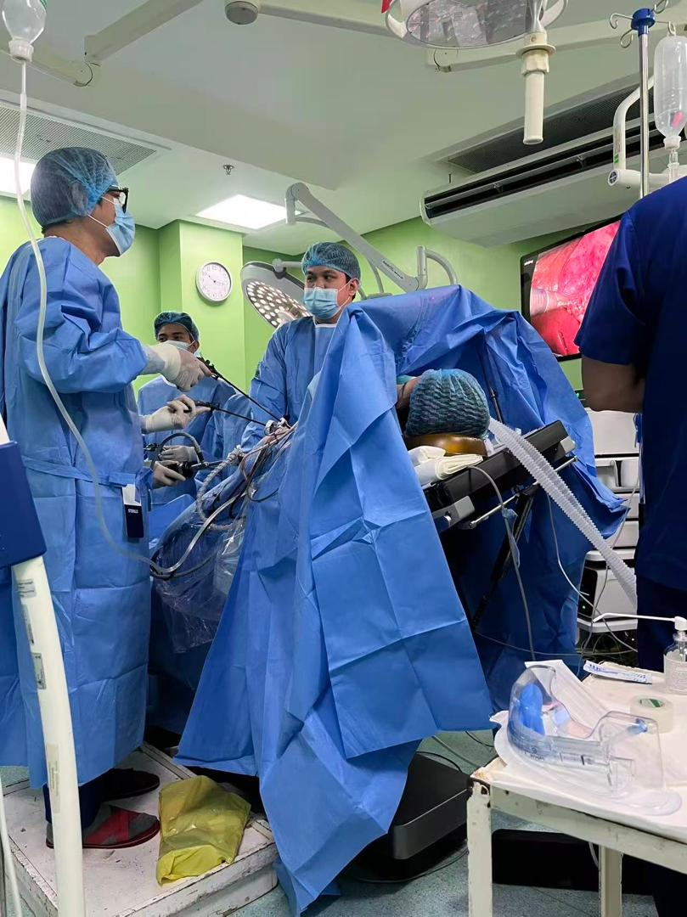
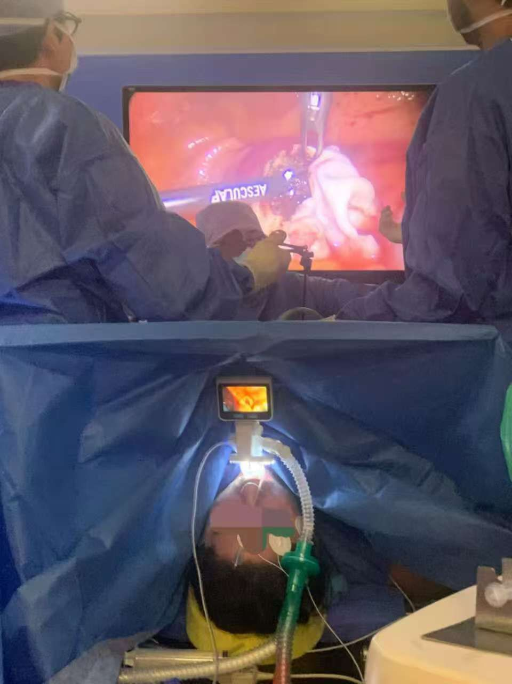
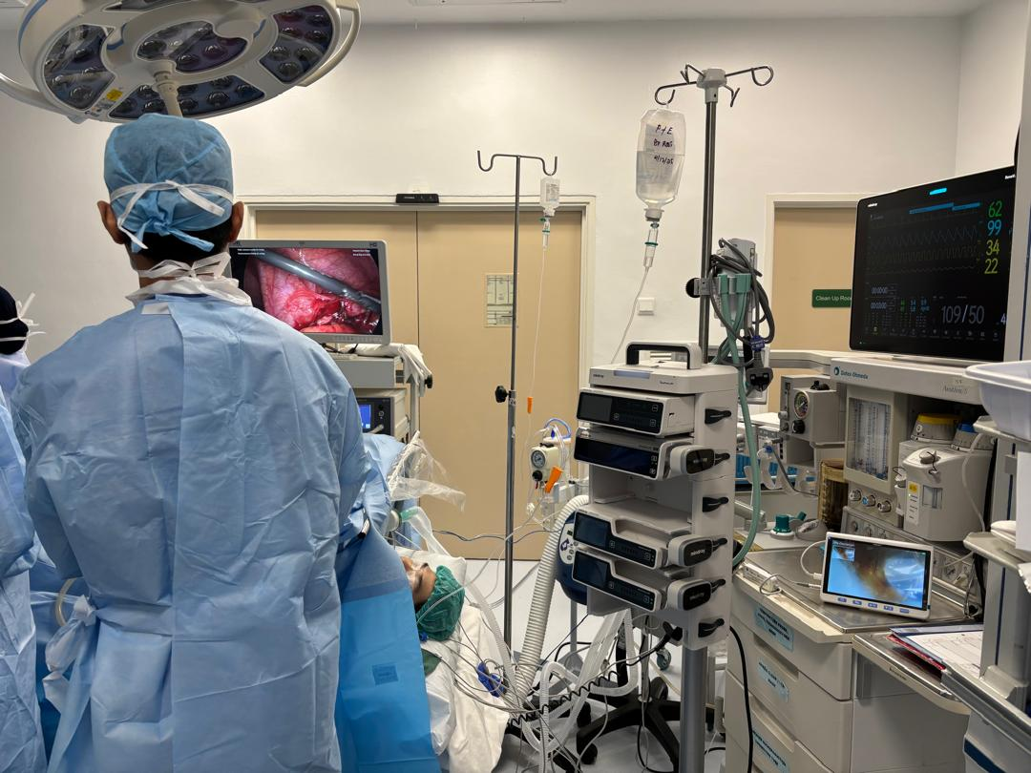
OTHER COUNTRIES USING SAFELM FOR LAPAROSCOPY
SafeLM can address the main airway management concerns in laparoscopy
SP-6 monitor in Tuscany, Italy
(2025)
A8 in Kuala Lumpur, Malaysia
(2025)
A8 in Hunan, China
(2025)
Cebu, Philippines
(2026)

Slide 12
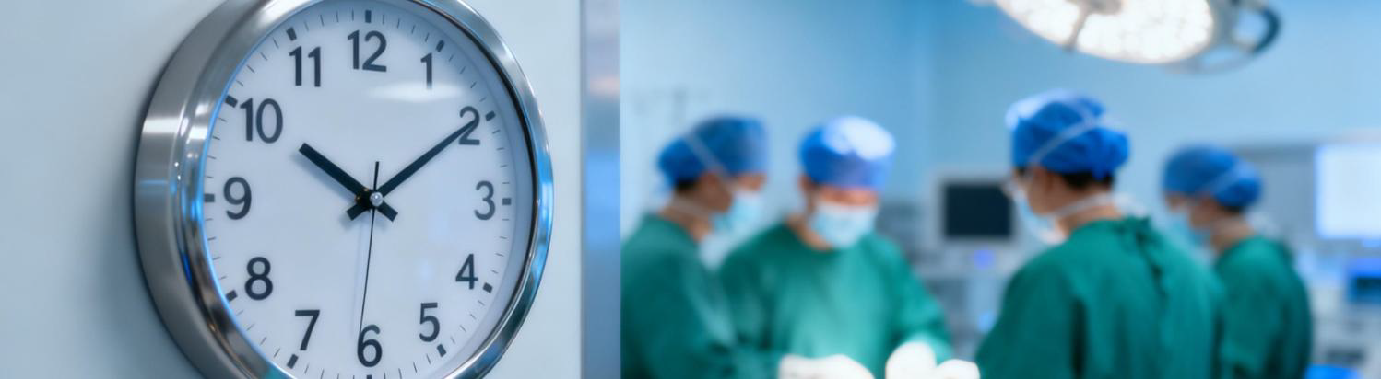
ADDITIONAL CLINICAL BENEFITS
Compared to endotracheal intubation
Potential benefits of SGA approach:
Reduced airway trauma
More stable hemodynamics
Less use of muscle relaxants
Faster recovery (ERAS)
These advantages may improve operating room efficiency and patient recovery.

Slide 13
SAFELM
VIDEO LARYNGEAL MASK
Magill Medical Technology
The only third generation supraglottic airway device
with an adjustable viewing angle
WWW.MAGILLMED.COM
Slide adaption from Tim Hoo

