Slide 1

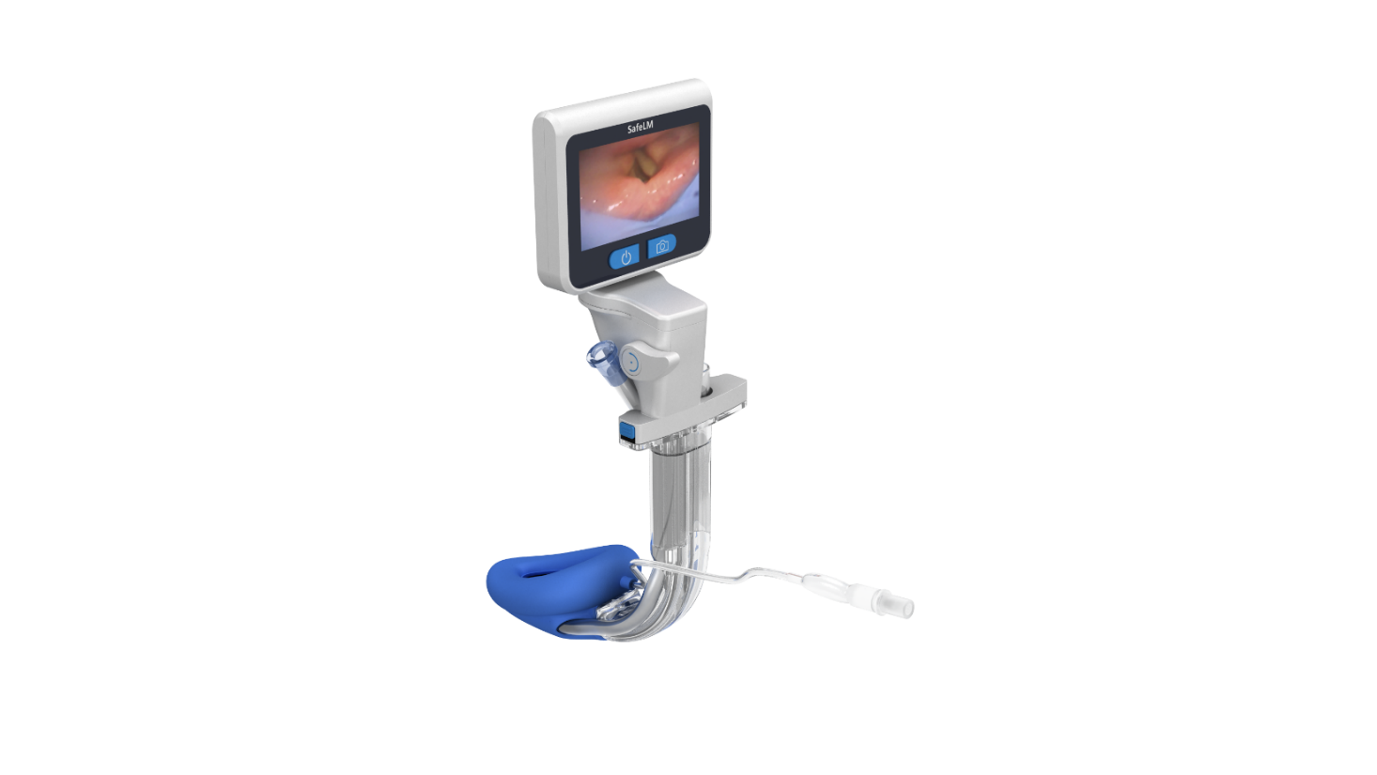
Magill Medical Technology
Innovation for Better Health
Hysteroscopy
SafeLM Third Generation Video Laryngeal Mask
Confidential

Slide 2
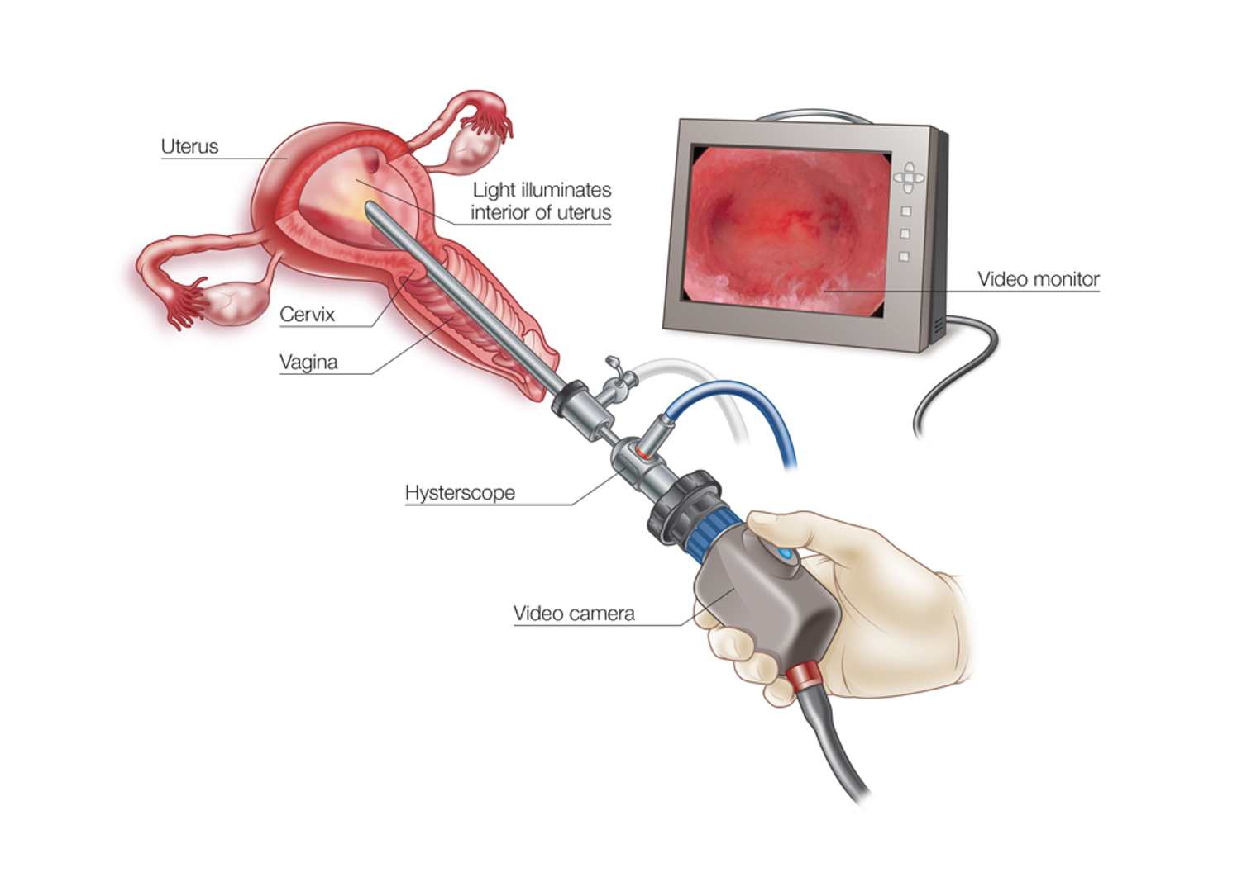
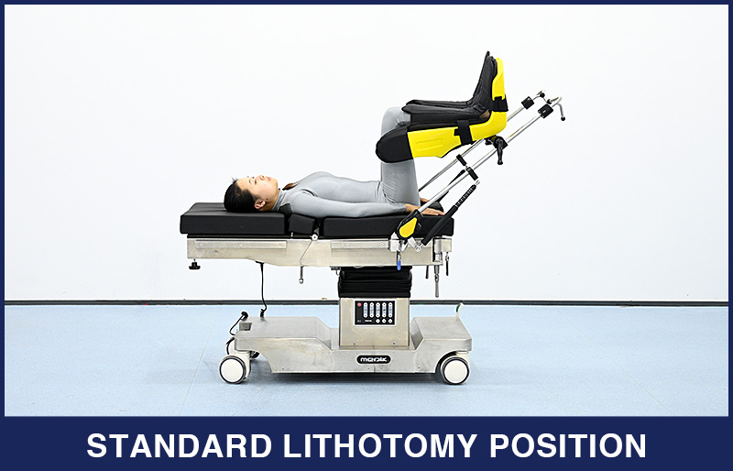
What is hysteroscopy?
Hysteroscopy is a minimally invasive procedure that uses a thin, lighted telescope to examine or treat the inside of the uterus. It allows diagnosis and management of conditions such as abnormal bleeding, polyps, fibroids, or intrauterine adhesions with reduced recovery time compared to open surgery.

Slide 3
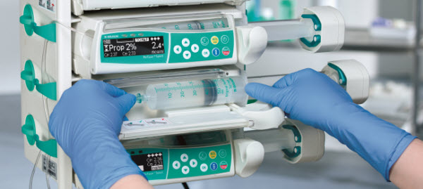
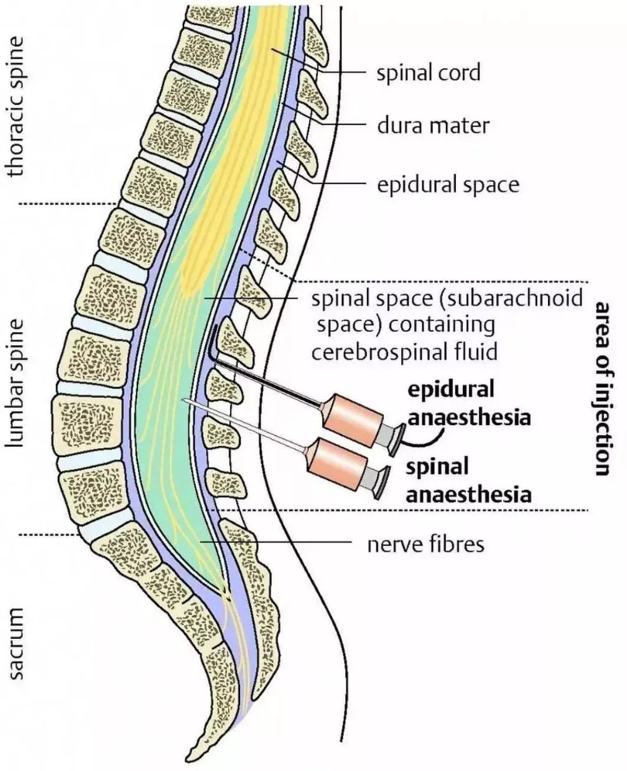
Challenges of Airway Management in Hysteroscopy
Some hospitals may use TIVA (total intravenous anaesthesia) for hysteroscopy cases, and others may opt for NA (neuraxial anaesthesia).
TIVA involves using intravenous agents (propofol) to induce and maintain unconsciousness without inhaled anesthetics, allowing precise control of depth and rapid recovery.
Neuraxial anesthesia, including spinal or epidural blocks, provides targeted sensory and motor blockade while preserving consciousness and reducing systemic drug exposure. The choice between the two depends on surgical requirements, patient comorbidities, and the need for airway control or hemodynamic stability.

Slide 4
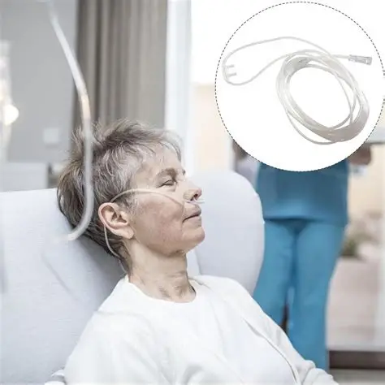
Benefits and Barriers of SGA Use in Hysteroscopy
Benefits | Barriers
Hysteroscopy procedures are usually short (~1-2 hours), laryngeal masks can provide secure ventilation under sedation. | Some procedures run longer than expected, or have an unpredictable duration, in which case anaesthetists will opt for endotracheal intubation as it is believed to be more secure
Use of a nasal cannula is usually insufficient in hysteroscopy. It does not provide airway protection or controlled ventilation, so generally suitable only for patients with low aspiration risk and stable respiratory function.
Reduce the need for muscle relaxant and muscle relaxant antagonists

Slide 5
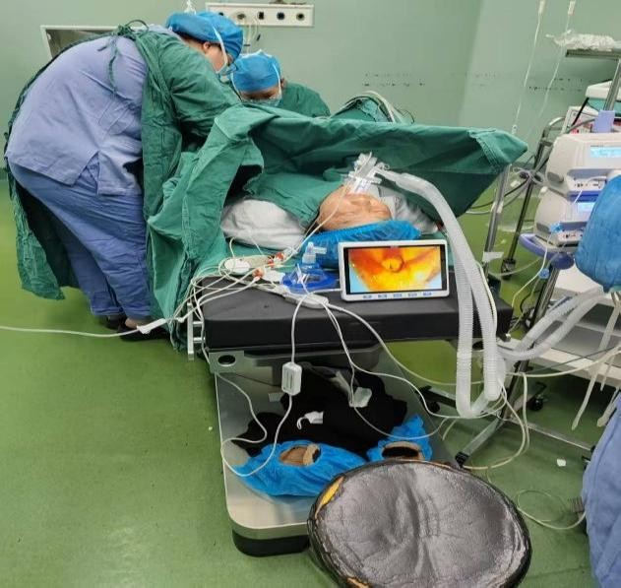
Unique Benefits of SafeLM in Hysteroscopy
Continuous monitoring supports the use of a laryngeal mask for controlled ventilation even during procedures with longer or unexpected duration
Decreases the need for muscle relaxants and deep anaesthesia, supporting faster recovery and improved patient comfort.
SafeLM can help detect whether the cause is laryngospasm, prompting the anaesthetist to increase the depth of anaesthesia or muscle relaxants

