Slide 1

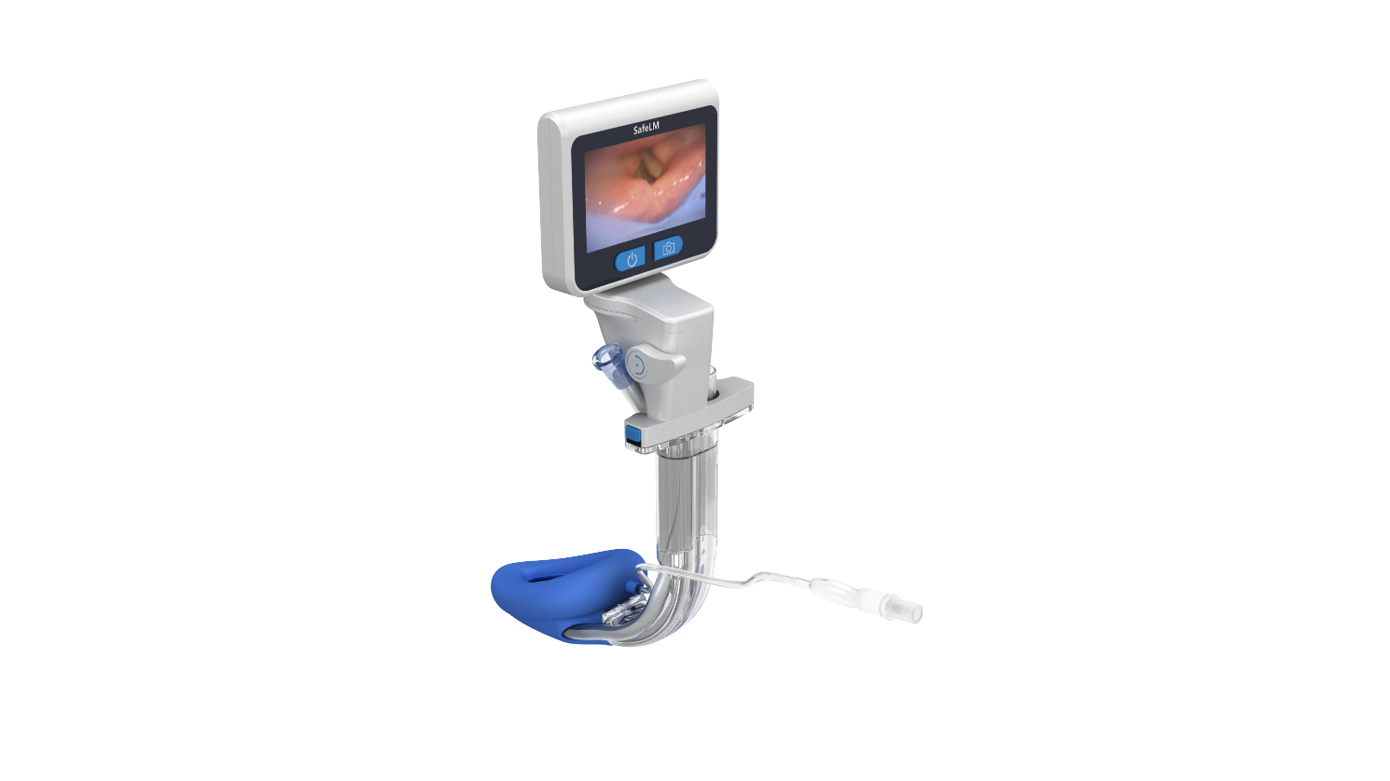
Magill Medical Technology
Innovation for Better Health
SafeLM® Video Laryngeal Mask System
3rd Generation Laryngeal Mask
With Adjustable Camera View of Glottic Opening
Economic Value of SafeLM®
Confidential – Do Not Distribute
保密资料 不得分发 Confidential

Slide 2
Economic Value of SafeLM®
01
02
03
04
Higher Bed
Turnover Rate
SafeLM® increases proportion of day care surgeries
Increase Scope
of Surgery
SafeLM® improves airway safety, broadens clinical use of SGA
Better Operating Room Efficiency
SafeLM® shortens induction and extubation time
Accelerates Postoperative Recovery
SafeLM® shortens hospital stay
Confidential – Do Not Distribute

Slide 3
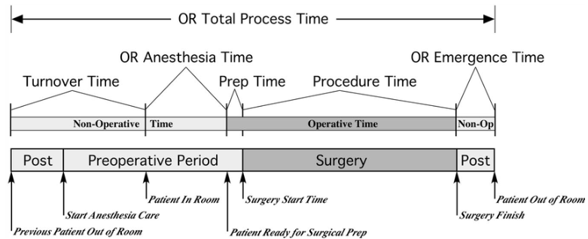
Operating Room Efficiency
Operating Room Time (ORT) is used to evaluate operating room efficiency. It refers to the period from the start of anesthesia induction to the completion of extubation procedure.
Anesthesia induction time: The period from when intravenous anesthetics (such as opiod, propofol, and muscle relaxant) are administered to when the patient is unconscious, stable, and ready for surgical positioning.
Surgery time: The time from the start of skin disinfection and draping to the completion of wound suturing.
Emergence time: The time from discontinuation of anesthetic drugs to the removal of the breathing tube.
Confidential – Do Not Distribute

Slide 4
Operating Room Efficiency
Shortens Anesthesia Induction Time
Compared with endotracheal intubation, insertion of SGA often does not require waiting for muscle relaxants to take effect, thereby shortening anesthesia induction time.
Shortens Emergence Time
When muscle relaxants are not used during surgery, the anesthesiologist does not need to wait for their complete metabolism and clearance. Once the patient regains spontaneous breathing, the airway device can be removed, thereby shortening postoperative extubation time.
Confidential – Do Not Distribute

Slide 5
Operating Room Efficiency
Boroda et al. found that among 139 pediatric patients undergoing adenoidectomy, the laryngeal mask group had an Operating Room Time (ORT) reduced by 20 minutes compared with the endotracheal intubation group (29.5 minutes vs. 49.5 minutes, P < 0.001), confirming that the use of a laryngeal mask can effectively shorten operating room time.¹
Another study reported that reducing preoperative preparation time (from anesthesia induction to the start of surgery) by 38.3% can increase the average number of daily surgeries per operating room by 1.6 cases.²
Published Research Evidence
1. Boroda N, Malesinska M, Kars M, Smith L: The use of laryngeal mask airway for adenoidectomy. International journal of pediatric otorhinolaryngology 2018, 107:42-44.
2. Madni T, Imran J, Clark A, Cunningham H, Taveras L, Arnoldo B, Phelan H, Wolf S: Prospective Evaluation of Operating Room Inefficiency. Journal of burn care & research : official publication of the American Burn Association 2018, 39(6):977-981.
Confidential – Do Not Distribute

Slide 6
Postoperative Recovery
Divided into three stages: early, intermediate, and late recovery.
Early Recovery (Phase I)
Takes place in the Post-Anesthesia Care Unit (PACU)
Focuses on airway protection, consciousness, vital signs stability, pain, and nausea control
Discharge from PACU based on Modified Aldrete Score ≥ 9
2. Intermediate Recovery (Phase II)
Occurs in the step-down or general ward.
Emphasis on regaining full physiological stability, ambulation, and oral intake. Ends when discharge criteria (e.g., mobility, pain control, no complications) are met.
3. Late Recovery (Phase III)
Occurs after discharge, at home.
Involves complete restoration of preoperative function and return to normal activities.
Confidential – Do Not Distribute

Slide 7
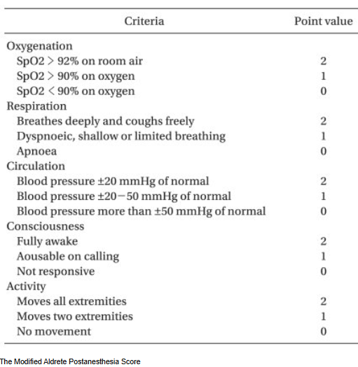
Enhance Postoperative Recovery
SafeLM® enables patients to recover rapidly, proceed to Phase II of recovery quicker.
Activity: SGA reduces or eliminates the need for muscle relaxants, allowing patients to regain voluntary or responsive limb movement soon after the procedure.
Respiration: Without muscle relaxants, patients maintain spontaneous breathing during surgery, allowing them to take deep breaths and cough effectively sooner. It also reduce nausea and vomiting post operatively.
Circulation: The laryngeal mask causes less cardiovascular stimulation and less blood pressure elevation.
Confidential – Do Not Distribute

Slide 8
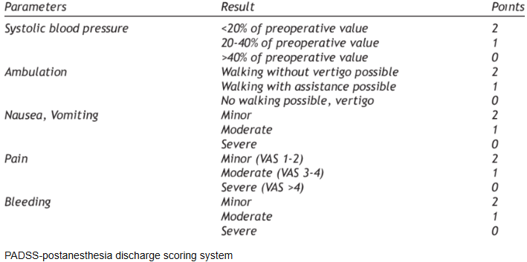
Enhance Postoperative Recovery
Systolic blood pressure:
Laryngeal mask causes less cardiovascular and airway stimulation, resulting in more stable vital signs after surgery
Nausea and Vomiting: Laryngeal mask reduces the need for intraoperative opioid use thus lowers the incidence of postoperative nausea and vomiting.
Pain: By avoiding tracheal intubation–related airway trauma, the laryngeal mask reduces postoperative coughing and sore throat.
Confidential – Do Not Distribute

Slide 9
Enhance Postoperative Recovery
Jia et al. found that in gynecologic laparoscopic surgery, the use of LMA reduced the incidence of coughing by 10% and sore throat by 5% compared with ETT. LMA use also lowered nausea and vomiting by 38%. In thoracic surgeries, LMA shortened hospital stay by about three days compared with endotracheal intubation. These studies demonstrate that LMA reduces postoperative complications and hospital stay.
Published Research Evidence
1. Jia Y, Zhang Y, Wang Z, Pan W, Fu H, Du W: Influence of endotracheal tube and laryngeal mask airway for general anesthesia on perioperative adverse events in patients undergoing laparoscopic hysterectomy: A propensity score-matched analysis. Journal of research in medical sciences : the official journal of Isfahan University of Medical Sciences 2023, 28:88.
2. Klockgether-Radke A, Gerhardt D, Mühlendyck H, Braun U: [The effect of the laryngeal mask airway on the postoperative incidence of vomiting and sore throat in children]. Der Anaesthesist 1996, 45(11):1085-1088.
3.Huang J, Huang W, Zhang J, Tan Z, Wang D: Application of laryngeal mask airway anesthesia with preserved spontaneous breathing in children undergoing video-assisted thoracic surgery. Frontiers in pediatrics 2023, 11:933158.
Confidential – Do Not Distribute

Slide 10
Daycare surgery
The International Association for Ambulatory Surgery (IAAS) defines day surgery as an operation or procedure carried out on a patient who is admitted, operated upon, and discharged on the same calendar day.”
The China Ambulatory Surgery Alliance defines day surgery as a new medical model guided by the Enhanced Recovery After Surgery (ERAS) concept, in which admission, surgery, and discharge are all completed within 24 hours.
In 2022, the National Health Commission released the “Interim Provisions on the Quality Management of Day Medical Services”, defining day medical care as a hospital-based medical service model that completes the entire inpatient diagnostic and treatment process within 24 hours.
Confidential – Do Not Distribute

Slide 11
Enhanced Recovery After Surgery (ERAS)
ERAS refers to a series of evidence-based perioperative management protocols designed to optimize patient care through the integration of anesthesia, analgesia, minimally invasive surgery, and multidisciplinary collaboration. The goal is to reduce postoperative complications and mortality, shorten hospital stay, and lower hospitalization costs.
The core concept of ERAS is to improve various aspects of perioperative management. These measures aim to minimize the patient’s physiological stress response, reduce discomfort, and promote early restoration of organ function, thereby enabling the patient to return to their preoperative condition as quickly as possible.
SafeLM ® enhances post-operative recovery, shortens hospital stay, aligns with the ERAS concept, and is well suited for airway management in day surgery.
Confidential – Do Not Distribute

Slide 12
SafeLM ® Impact on Daycare Surgeries
Accelerates Patient Emergence and Recovery
Laryngeal mask airway (LMA) causes less airway trauma and irritation compare with endotracheal intubation (ETT
reduced or no use of muscle relaxants during the procedure.
Converts Inpatient Surgeries into Day Surgeries
Expands the scope of day surgery applications, improves bed turnover efficiency, and further increases the proportion of day surgeries among elective procedures.
Confidential – Do Not Distribute

Slide 13
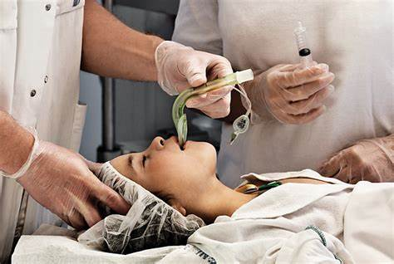
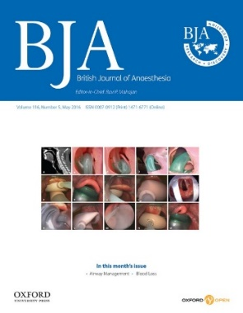
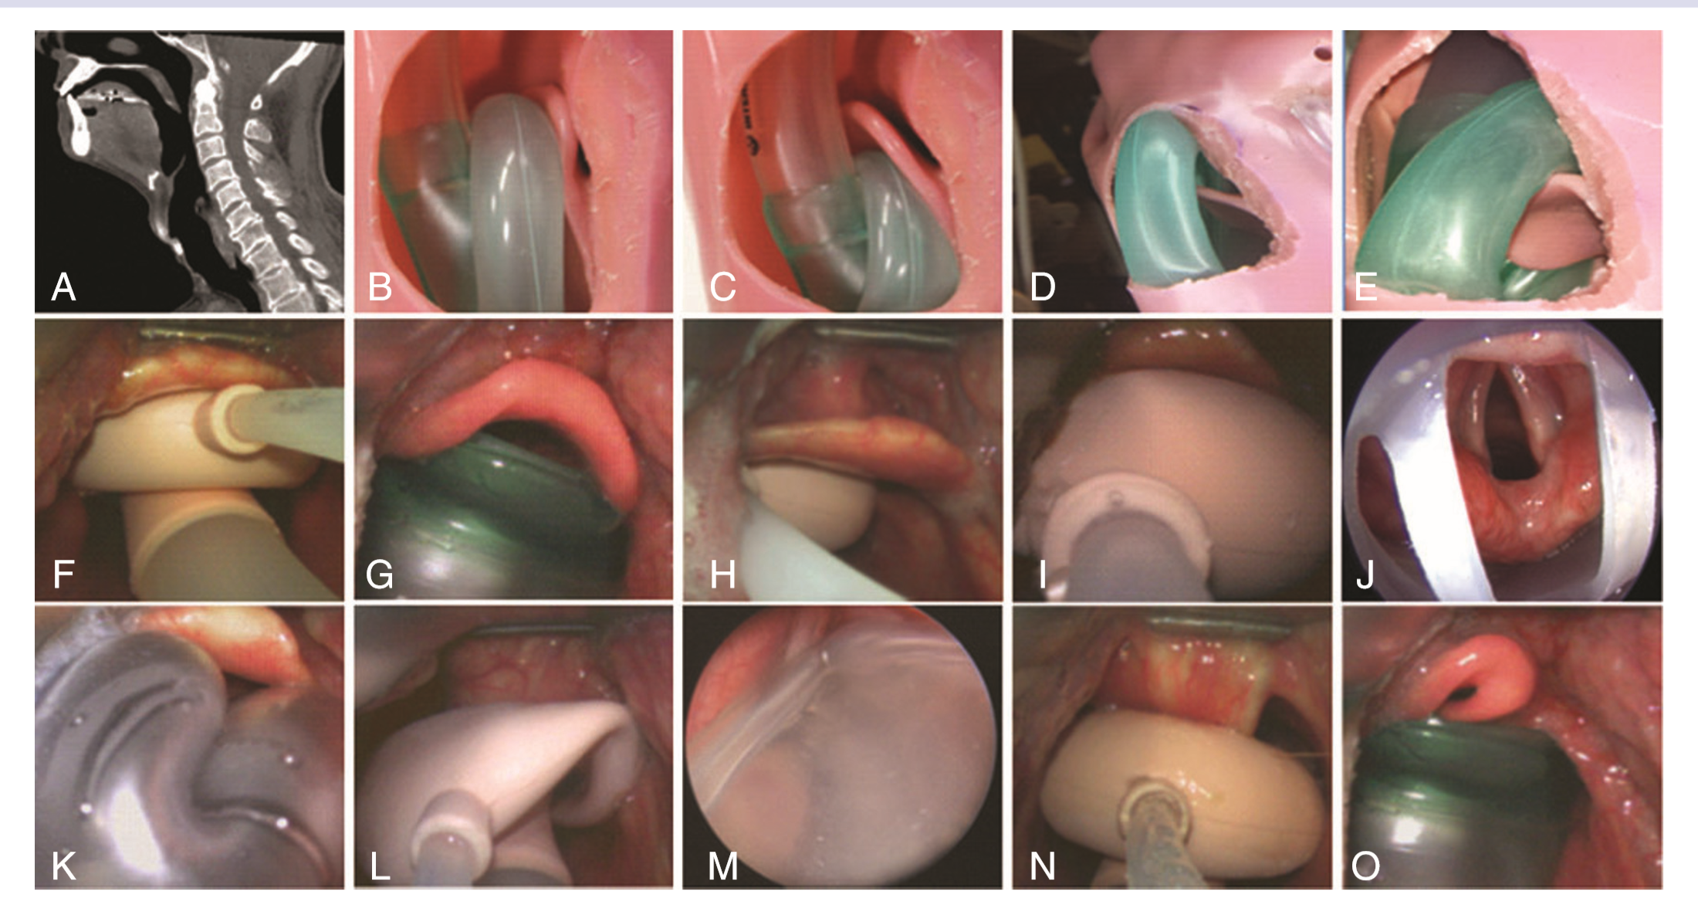
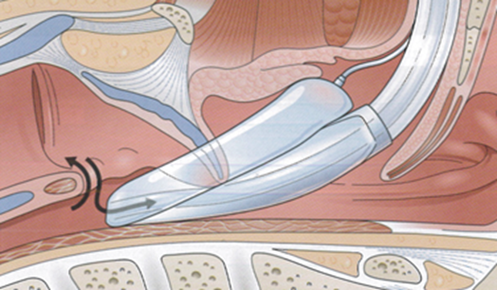
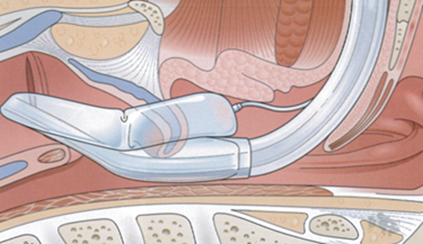
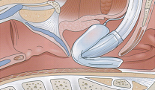
Clinical Challenges of Blind SGA Insertion
A 2016 BJA study reported a 50–80% malposition rate for blindly inserted laryngeal masks
喉罩位置评分标准
Insufficient depth (15%)
Glottic placement (6%)
Cuff folding (3.4%)
A. A. J. Van Zundert, Malpositioning of supraglottic airway devices: preventive and corrective strategies British Journal of Anesthesia 116 (5): 579–82 (2016) doi:10.1093/bja/aew104

Slide 14
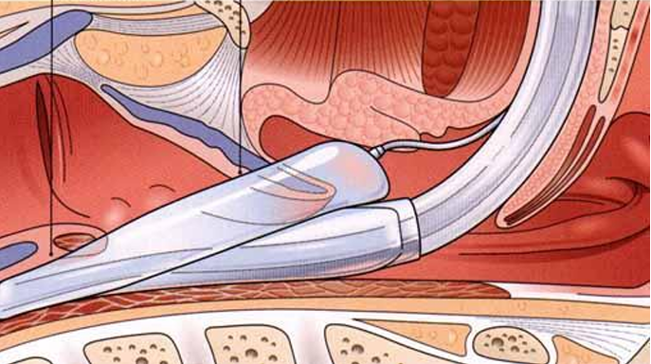
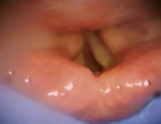
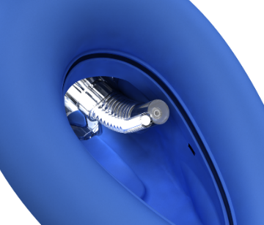
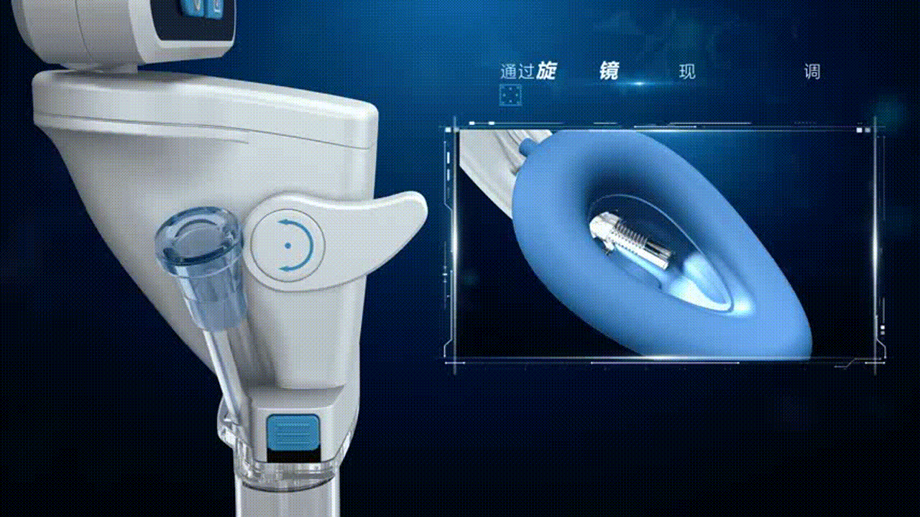
SafeLM ® Enhance Safety of Airway Management
SafeLM® incorporates advanced video imaging technology which helps visualisation of airway placement, something conventional laryngeal masks cannot offer. We have been granted an international patent and is recognized as the first and real third-generation laryngeal mask.
>180° field of camera view, it provides full visualization of the glottis, ensuring accurate placement and a secure seal between the mask and the glottic opening.
SafeLM® innovative design helps achieve higher oropharyngeal leak pressure (OLP), with a sealing pressure range of 35–40 cmH₂O, effectively preventing displacement, air leakage, and the risks of reflux or aspiration during mechanical ventilation.
Confidential – Do Not Distribute

Slide 15
SafeLM® Broadens Clinical use of SGA
Contraindications According to the“Expert Consensus on the Clinical Application of the Laryngeal Mask Airway” published in the Journal of Clinical Anesthesiology in 2024, prolonged surgery, significant changes in patient positioning, and a high risk of laryngeal mask displacement are considered relative contraindications for LMA use.
In laparoscopic surgeries, elevated intra-abdominal pressure and high peak airway pressure during ventilation can increase the risk of LMA displacement, air leakage, reflux, and aspiration.
Therefore, endotracheal intubation (ETT) is generally preferred in such cases, and traditional LMAs should be used with caution.
Confidential – Do Not Distribute

Slide 16
SafeLM® Broadens Clinical use of SGA
Traditional LMAs have lower OLP and lack visualization during placement, which increases the risk of malposition and associated complications
SafeLM® overcomes traditional limitations of LMAs
High oropharyngeal leak pressure (OLP), better sealing performance.
Real-time visual monitoring allows timely suction of gastric content reflux which prevent aspiration, ensuring patient safety.
These advantages make SafeLM® suitable for laparoscopic surgeries with elevated intra-abdominal pressure, long-duration procedures, and surgeries performed in lateral or prone positions, where the risks of reflux, aspiration, displacement, and air leakage are higher.
Confidential – Do Not Distribute

Slide 17
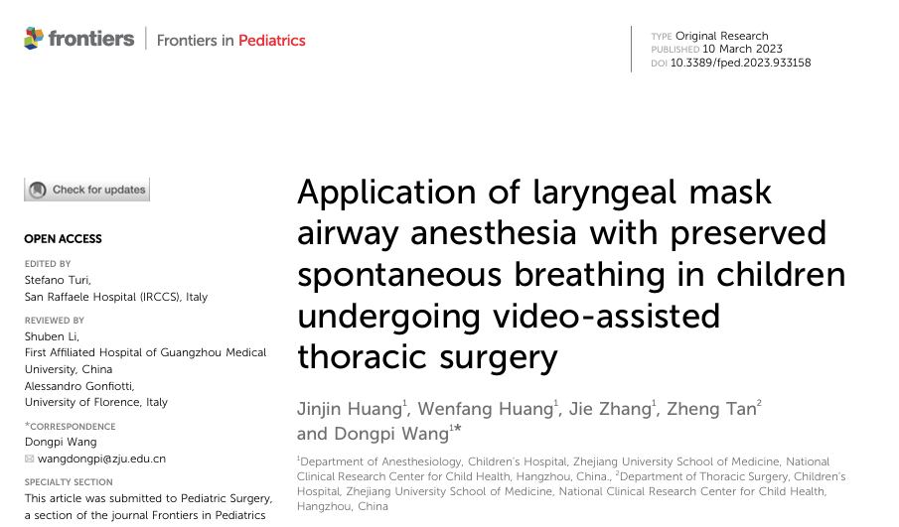
SafeLM® broadens clinical use of SGA
Tubeless anesthesia is an innovative anesthetic technique used in video-assisted thoracoscopic surgery (VATS), in which a laryngeal mask airway (LMA) is employed to maintain spontaneous breathing during general anesthesia. This method uses a non-invasive airway device that does not enter the trachea and is combined with regional anesthesia and intravenous sedation and analgesia to achieve the principles of Enhanced Recovery After Surgery (ERAS).
Fewer pulmonary complications
Minimal postoperative sore throat, hoarseness, and coughing
Shorter anesthesia recovery and overall recovery time
Reduced duration of chest drainage
Shorter postoperative hospital stay and lower hospitalization costs
Confidential – Do Not Distribute

Slide 18

Magill SafeLM® Video Laryngeal Mask
Truly visual,
Shaping the future
Magill Medical
Innovation for Better Health

