Slide 1
Evolution of Supraglottic Airway Devices
Dr Archie Brain invented and developed first prototype of SGA in 1981
Tested on > 7,000 subjects before the initial commercial devices were launched in 1988.
First-generation devices are simple airway tubes that do not have specific design characteristics aimed at reducing the risk of pulmonary aspiration of gastric contents.
Second-generation devices have integrated bite blocks, gastric channel which reduces risk of pulmonary aspiration of gastric contents, design changes help it acts better as conduits for tracheal tube placement

Slide 2
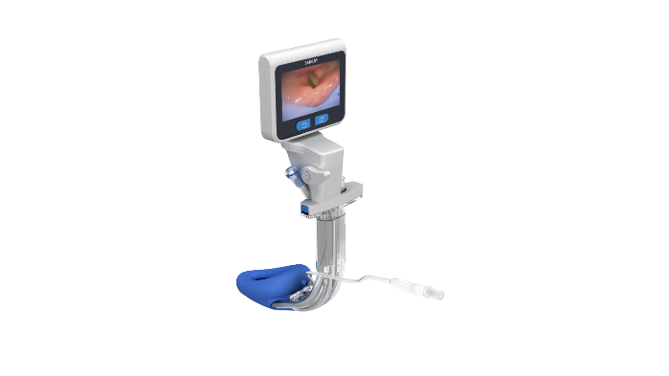
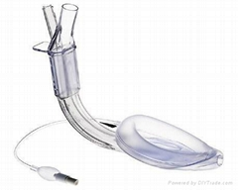
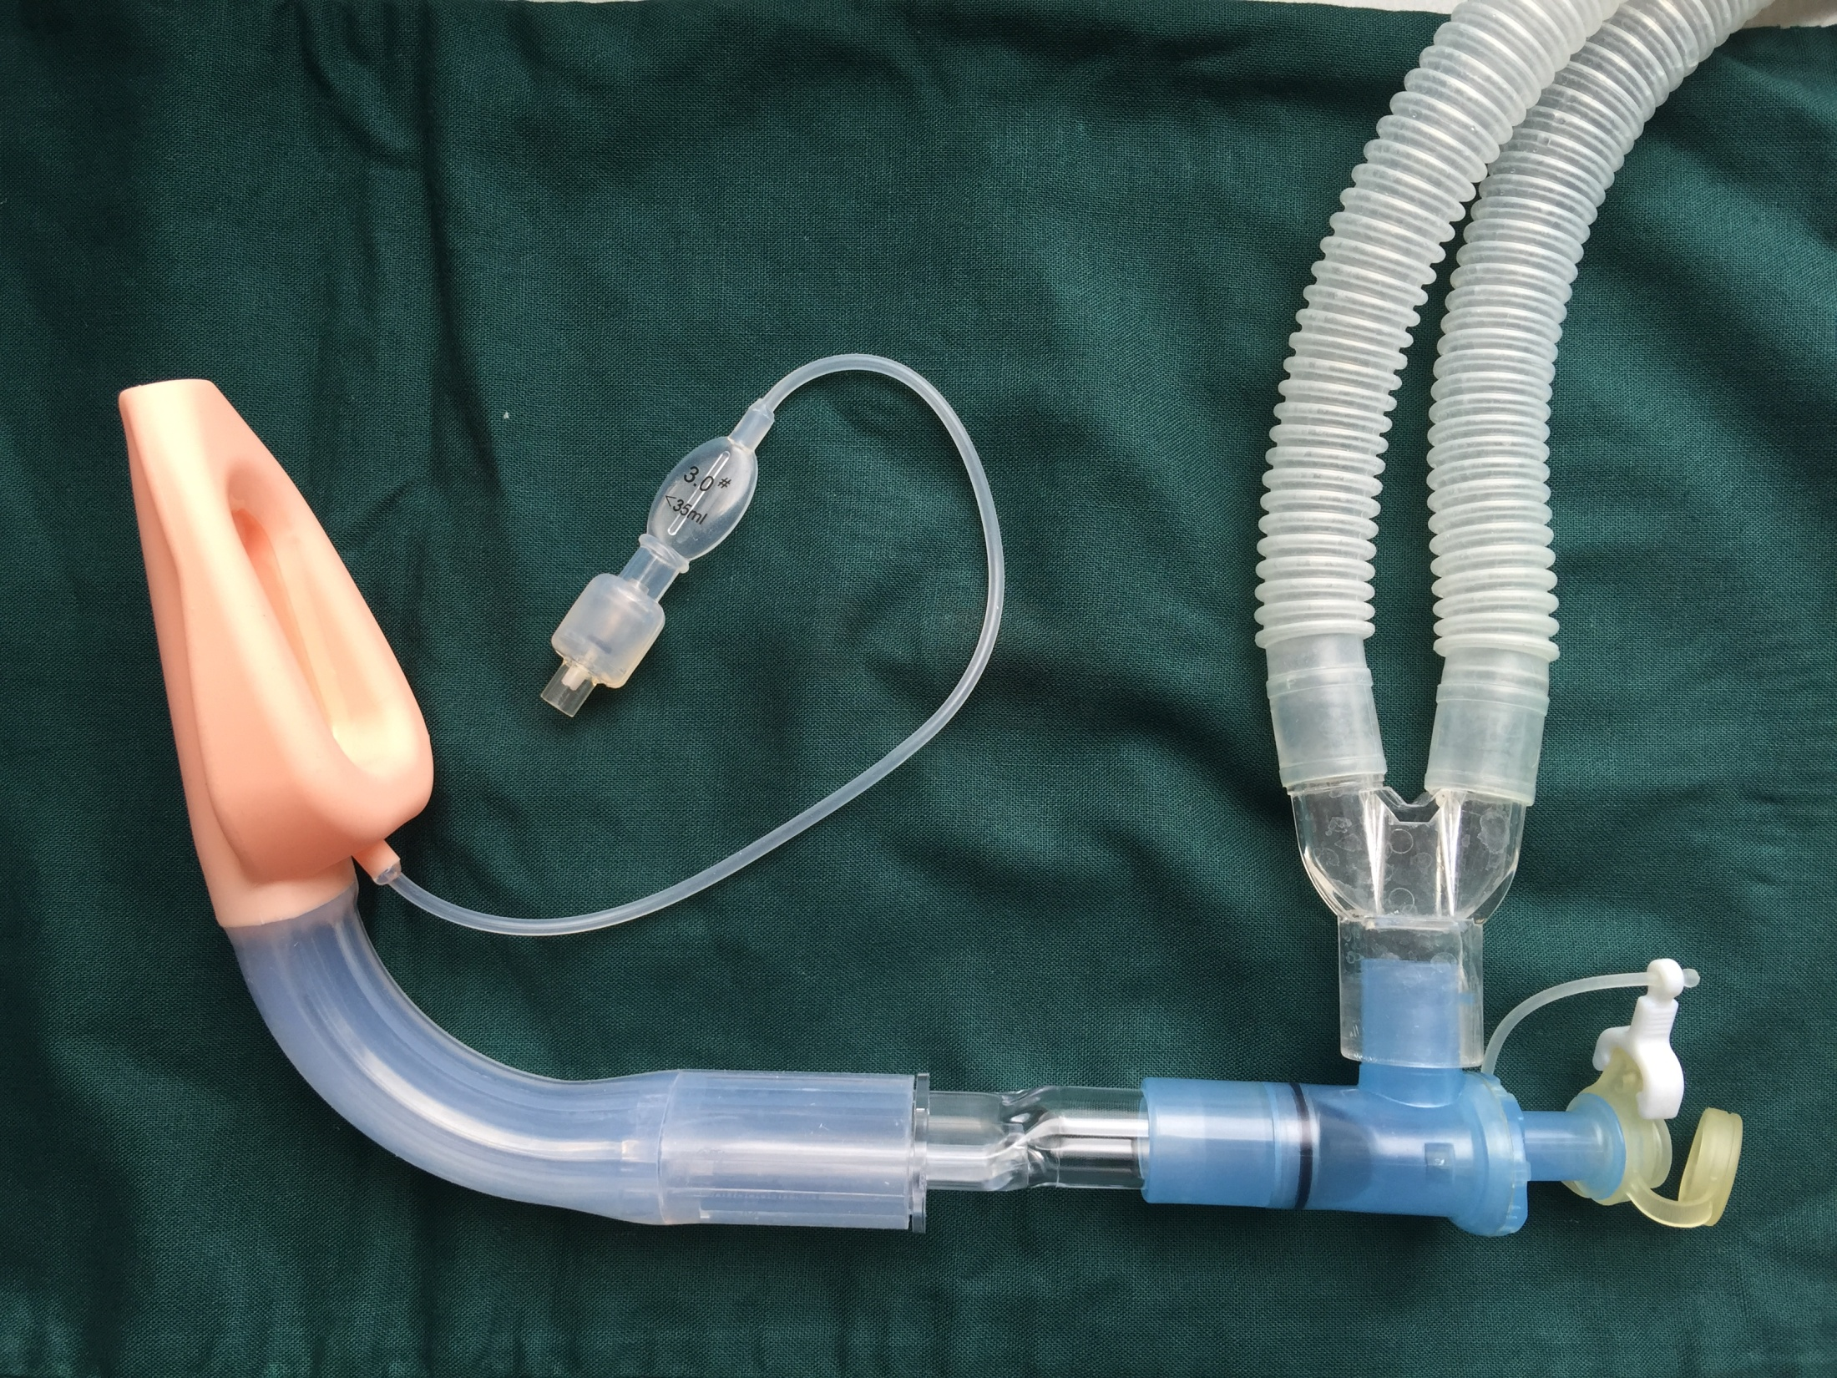
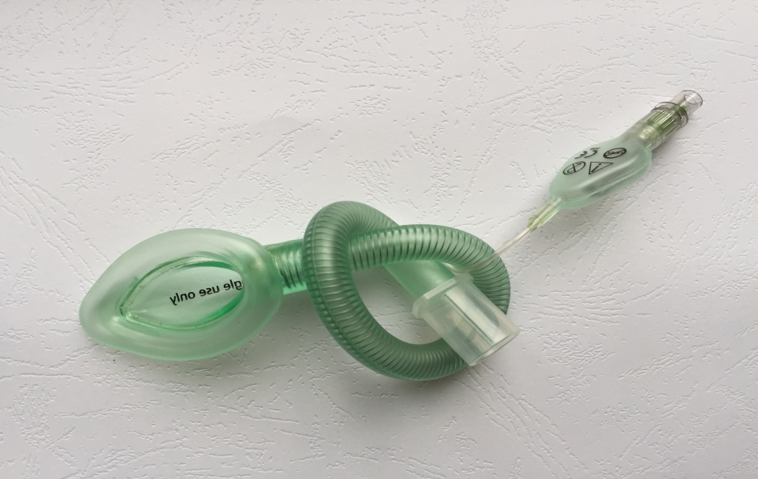
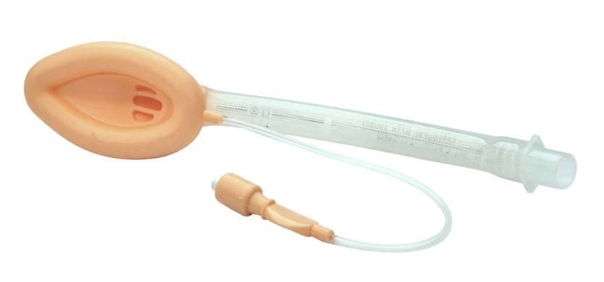
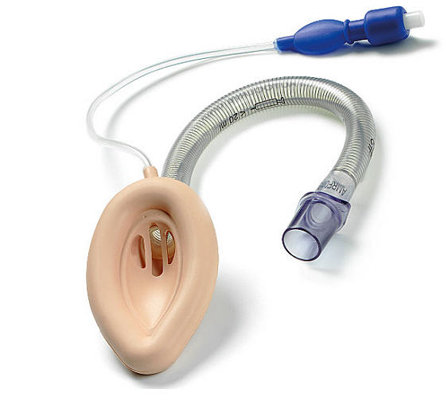
Generations of Supraglottic Airway Devices
3rd Gen. + video channel
2nd Gen：+ gastric channel
1st Gen：only airway channel

Slide 3
SGAs are better than ETTs
SGA can be used for airway management in anesthesia and emergency medicine to keep the upper airway clear for unobstructed ventilation.
Four decades since supraglottic airways (SGAs) were introduced into anesthetic practice. However, they have not become the standard of care for some anesthesiologists, largely due to concerns about dislodgement and reduced airway control compared to endotracheal tubes (ETTs).
Multiple large-scale clinical trials and systematic reviews have confirmed the safety, reliability, and efficacy of SGAs across a wide range of surgical settings.

Slide 4
SGAs are better than ETTs
In fact, SGAs are associated with several advantages when compare to ETT reduced airway morbidity, lower incidence of sore throat, and ease of insertion, without compromising patient safety.
Advantages of SGA over ETT
Easier and quicker insertion
Reduction in neuromuscular blocking drug (NMBD) usage
Hemodynamic stability
Less invasive, reduced airway trauma
Less emergence coughing, hoarseness, sore throat
Rescue device in difficult airway management

Slide 5
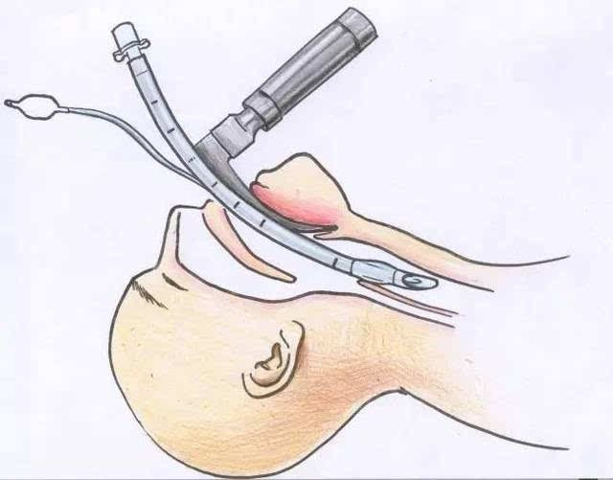
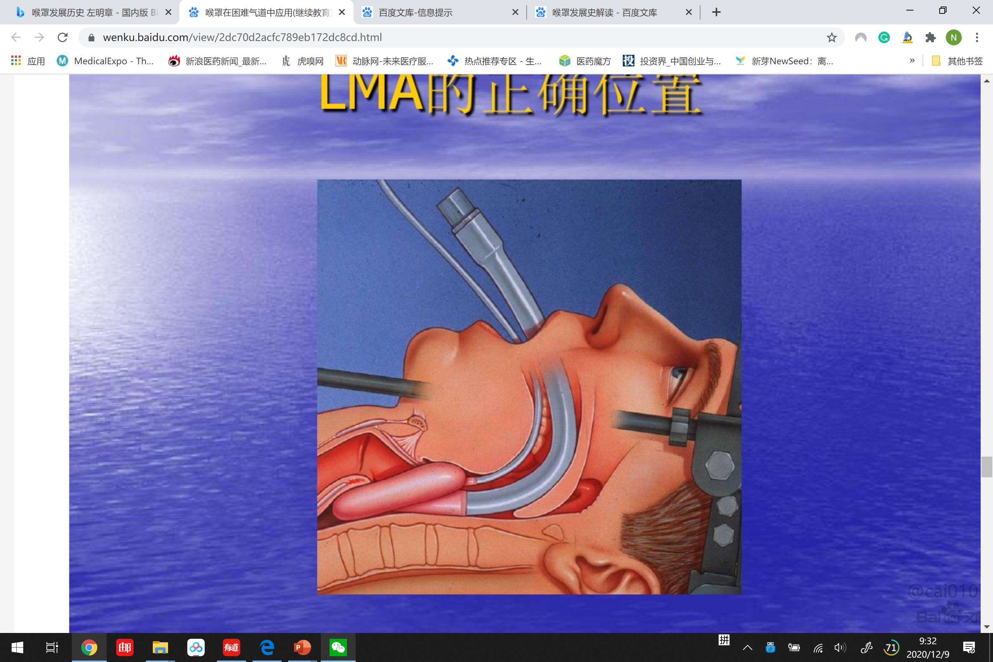
SGA vs ETT
Feature | Endotracheal Tube | Supraglottic Airway Device
Insertion | Requires laryngoscopy, more technically demanding | Easier insertion
Skills required | Required more skills and experience | Easier for less experience personnel
Airway/dental trauma¹ | Higher risk | Lower risk
Muscle relaxant and reversal agents | Required | Optional, often not required
Drug-related complications^{2,3} | Higher incidence | Lower incidence
Notes:
Let’s see the comparisons, for ETT insertion it requires a laryngoscopy which demands more skills and it might injured patient’s airway causing airway trauma/dental injury. Muscle relaxant is also needed, and of course reversal agent to unparalysed the patient before extubation. More drugs means more potential drug-related complications. Laryngeal mask will easier for insertion, causing less airway trauma. Muscle relaxant is often not required, but it also depends on the Anaesthesiologists’ preference and surgery type.

Slide 6

SGA vs ETT
Feature | Endotracheal Tube | Supraglottic Airway Device
Hemodynamic^{4,5} | More impact (due to sympathetic response) | Less impact
Intraocular pressure⁶ | More impact | Less impact
Post-op complications⁷ | Coughing, sore throat, hoarseness are common | Less
Post op recovery | Slower | Faster
Dr. Joseph Brimacombe showing comfort and secure airway seal of Laryngeal Mask
Notes:
ETT can trigger sympathetic responses such as tachycardia and hypertension, and can increase intraocular pressure, all due to laryngoscope blade manipulation. LMA, on the other hand, tends to cause less hemodynamic disturbance and has a milder impact on intraocular pressure. Post op complications such as sorethroat, hoarseness, coughing are more common on patients intubated with ETT. Recovery times also tend to be longer in the ETT group.

Slide 7
SGA vs ETT
Publications that proved safety and efficacy of SGAs comparable to ETTs
1. Park, S. K., Ko, G., Choi, G. J., Ahn, E. J., & Kang, H. (2016). Comparison between supraglottic airway devices and endotracheal tubes in patients undergoing laparoscopic surgery: A systematic review and meta-analysis. Medicine, 95(33), e4598. https://doi.org/10.1097/MD.0000000000004598
-> A systematic review and meta-analysis of 17 studies found that SGAs and ETTs had comparable insertion success rates, insertion times, and oropharyngeal leak pressures in patients undergoing laparoscopic surgery.

Slide 8
SGA vs ETT
2. Nair, A., Borkar, N., Murke, S. S., & Dudhedia, U. (2024). Safety and efficacy of the use of supraglottic airway devices in children and adolescents undergoing adenotonsillectomy—A systematic review and meta-analysis. Journal of Personalized Medicine, 14(3), 311. https://doi.org/10.3390/jpm14030311
->SGAs have been shown to be effective alternatives to ETTs, offering less irritation to reactive airways and reducing perioperative complications like coughing and laryngospasm in pediatric patients

Slide 9
SGA vs ETT
3. Kumar, T., Bharati, B., Suman, S., Kumar, S., Acharya, G., & Lakra, L. (2023). Supraglottic airway devices versus endotracheal intubation for laparoscopic surgeries: An updated systematic review and meta-analysis of randomised controlled trials. Indian Journal of Anaesthesia, 67(5), 409–419. https://doi.org/10.4103/ija.ija_398_22
-> A recent meta-analysis by Kumar et al. (2023) found that SGAs were associated with significantly lower incidences of sore throat and hoarseness postoperatively (RR ~0.44 for sore throat; RR ~0.38 for hoarseness) and fewer occurrences of cough, without significant increase in more serious airway complication

Slide 10
SGA vs ETT
4. Brimacombe, J. (1995). The advantages of the LMA over the tracheal tube or facemask: A meta-analysis. Canadian Journal of Anaesthesia, 42(11), 1017–1023. https://doi.org/10.1007/BF03011075
-> The meta-analysis by Brimacombe (1995) found that the Laryngeal Mask Airway (LMA) has advantages over the tracheal tube (TT), including better hemodynamic stability during induction and emergence, less postoperative sore throat, and reduced coughing during emergence.
Thus, the perception of SGAs as inferior to ETTs in terms of airway security should no longer be considered a barrier

Slide 11
References
Brimacombe J. The advantages of the LMA over the tracheal tube or facemask: a meta-analysis. Can J Anaesth 1995; 42:1017–1023.
Seung HY, Beirne OR. Laryngeal mask airways have a lower risk of airway complications compared with endotracheal intubation: a systematic review. J Oral Maxillofac Surg 2010; 68:2359–2376.
Cook T, Howes B. Supraglottic airway devices: recent advances. Continuing Educ Anaesth Crit Care Pain 2011; 11:5
Ozdamar D, Guvenc BH, Toker K, et al Comparison of the effect of LMA and ETT on ventilation and intragastric pressure in pediatric laparoscopic procedures. Minerva Anestesiol 2010; 76:592–599.

Slide 12
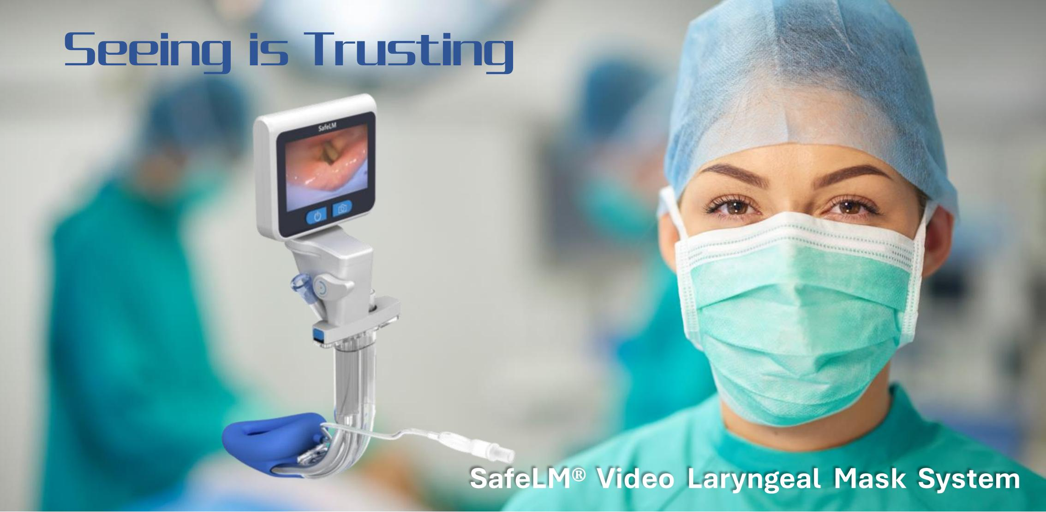
Changsha Magill Medical Technology Co. Ltd.

