Slide 1

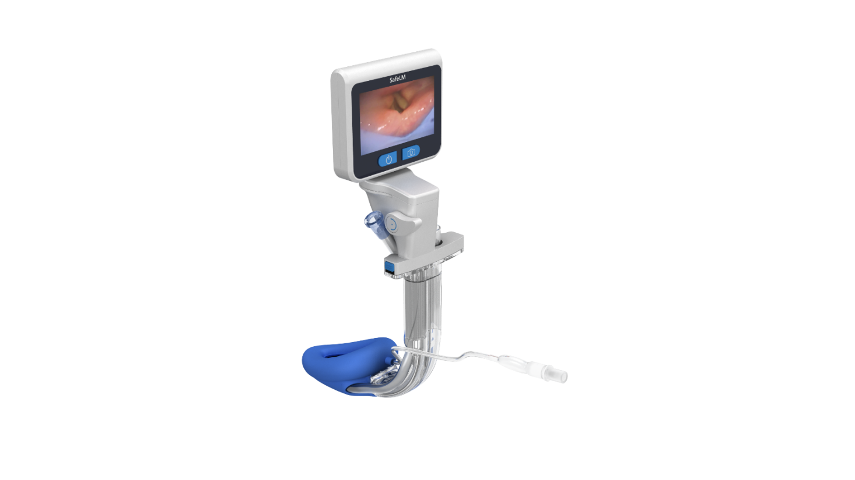
Magill Medical Technology
Innovation for Better Health
Neuro/Eye/ENT
Dr. Sabrina Tee
Global Clinical Education Manager
Confidential

Slide 2
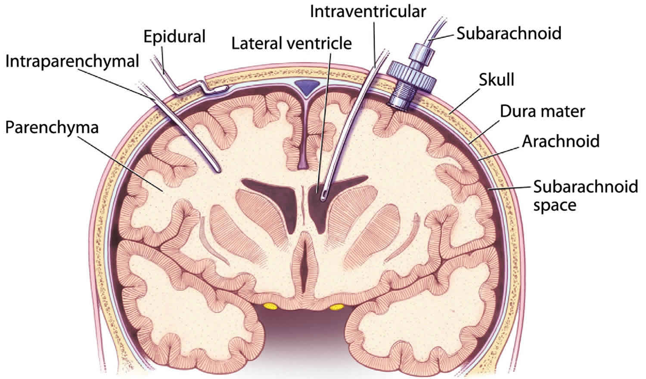
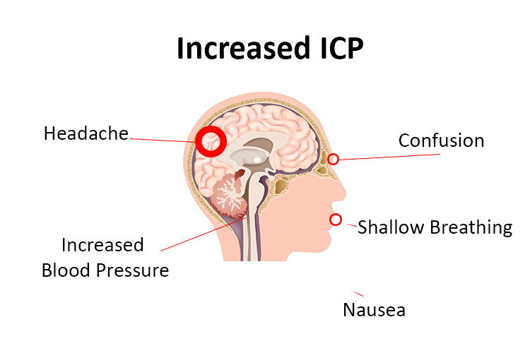
Considerations in Neurosurgical Airway Management
Intracranial pressure (ICP)
Laryngoscopy and intubation can cause sympathetic stimulation → raised ICP and raised BP
Need to ensure adequate anaesthetic depth
Cervical spine stability
Trauma, tumors or degenerative disease may make neck movement dangerous
Avoid direct laryngoscopy
Difficult airway risk
Positioning challenges (prone or sitting)
Ventilation goals
Maintain normocapnia (CO2 levels) to avoid ICP fluctuations
Avoid hypoxia and hypercarbia, which worsen cerebral edema

Slide 3
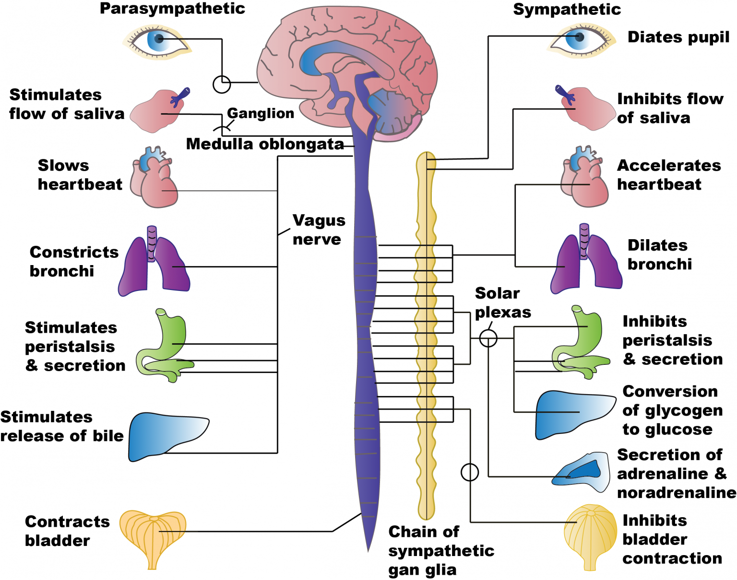
Benefits of an SGA in Neurosurgery
Reduced hemodynamic stress compared with endotracheal intubation, helping limit spikes in blood pressure and intracranial pressure during airway manipulation (→ inadequate perfusion, tissue hypoxia, herniation)
Less coughing and bucking on emergence, which may decrease abrupt increases in intracranial pressure and improve surgical conditions.
Avoidance of muscle relaxants and muscle relaxant antagonists in selected cases, allowing earlier neurological assessment postoperatively.

Slide 4
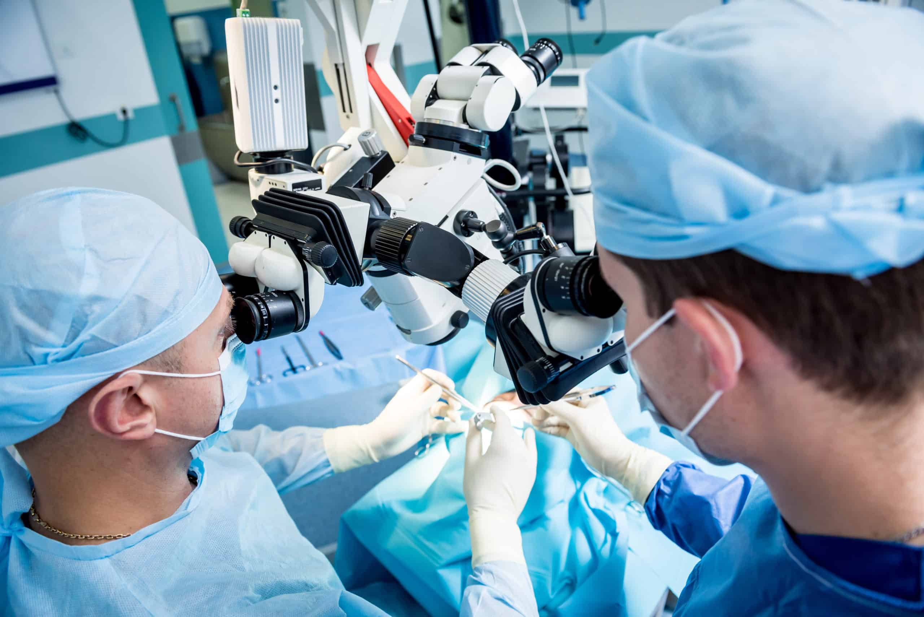
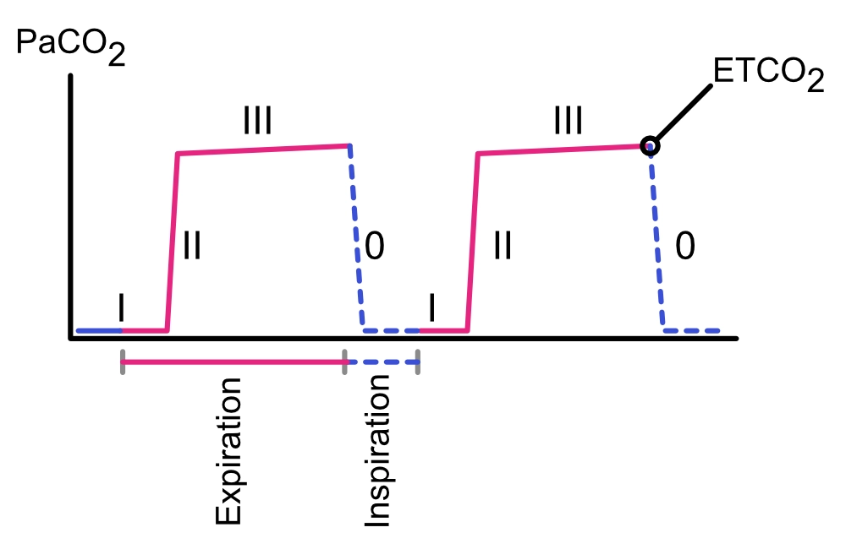
Barriers to SGA use in Neurosurgery
Limited airway protection against aspiration, particularly concerning patients with impaired consciousness, reflux, or prolonged procedures.
Reduced suitability for long surgeries, prone positioning, or cases requiring tight control of ventilation and carbon dioxide levels.
Risk of displacement once the head is fixed or draped, making airway access difficult intraoperatively.
Preference for endotracheal tubes in many neurosurgical settings due to their reliability, familiarity, and ability to ensure controlled ventilation and airway security.

Slide 5
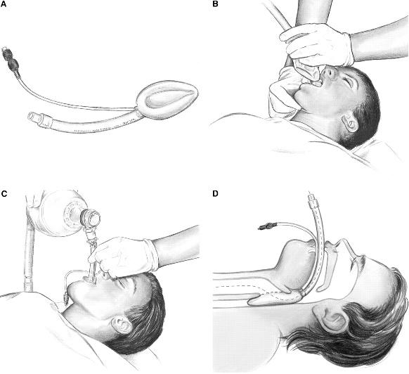
Unique Benefits of SafeLM in Neurosurgery
Enables atraumatic, well-controlled airway placement with continuous visualization, reducing airway manipulation and cervical movement—important in patients with unstable spines or elevated ICP risk.
Supports hemodynamic stability by avoiding direct laryngoscopy, thereby minimizing sympathetic surges that could increase intracranial pressure or cerebral blood flow.
Facilitates rapid emergence and neurological assessment by reducing anesthetic depth, opioid requirements, and residual neuromuscular blockade.
Supports a guided Bailey maneuver
The Bailey maneuver is an airway exchange technique in which a laryngeal mask airway (LMA) is inserted behind an endotracheal tube before extubation, allowing the tube to be removed while maintaining airway control. The LMA provides a smooth transition during emergence, reducing coughing, bucking, and hemodynamic stress.

Slide 6
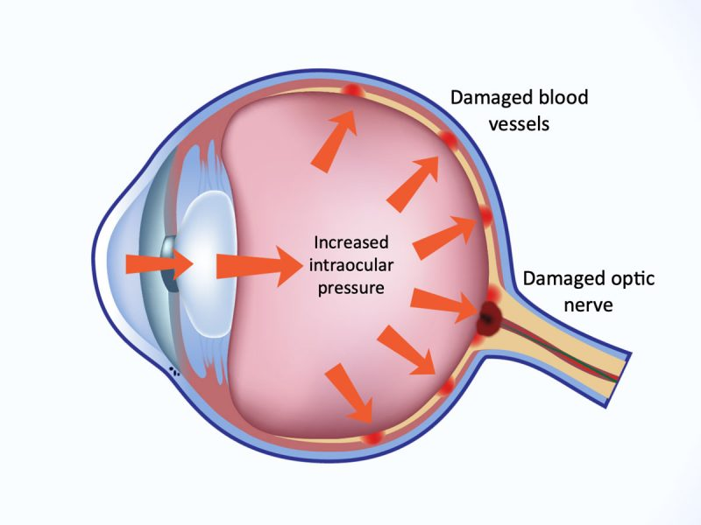
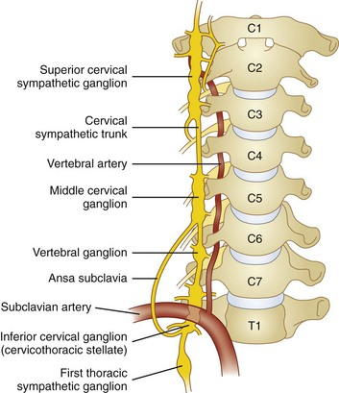
Airway Considerations in Ophthalmic Surgery
Stable intraocular pressure (IOP) Avoid coughing, bucking, straining, hypercarbia, and hypoxia. Favor gentle induction, adequate depth, and smooth emergence; avoid agents or maneuvers that raise IOP (e.g., forceful mask ventilation, inadequate analgesia).
Minimal airway stimulation: Choose devices and techniques that reduce laryngotracheal irritation; secure the airway to prevent movement under drapes and limited access.
Rapid recovery and low PONV: High post operative nausea/vomiting risk in ophthalmic cases—optimize antiemetics and avoid emergence agitation that can spike IOP and jeopardize surgical outcomes.

Slide 7
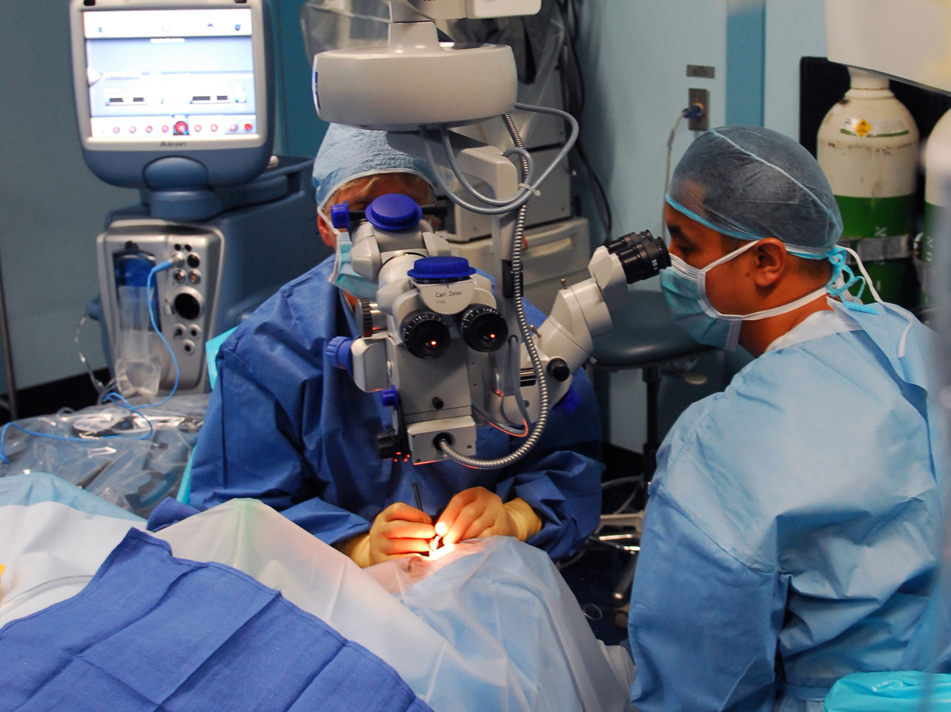
Benefits and Barriers of an SGA in Eye Surgery
Benefits | Barriers
Provides a secure airway with minimal hemodynamic response, reducing coughing or movement that could compromise delicate ocular procedures on insertion and removal | Aspiration risk, especially in longer surgeries
Reduced airway trauma, improved recovery quality, faster patient recovery and shorter hospital stay | Anticipated need for higher airway pressures
Most ophthalmic procedures are short, laryngeal mask use supports faster turnover and improved efficiency | Need for microscope to go close to the eye/face
Lower risk of coughing on extubation compared to ETT, preventing rise in intra-ocular pressure

Slide 8
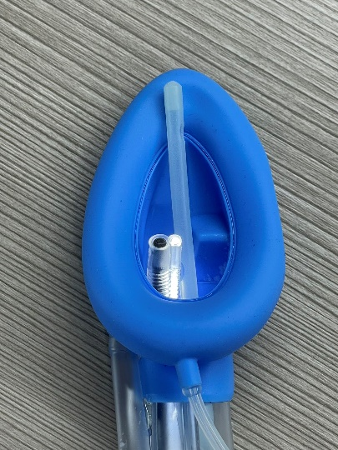
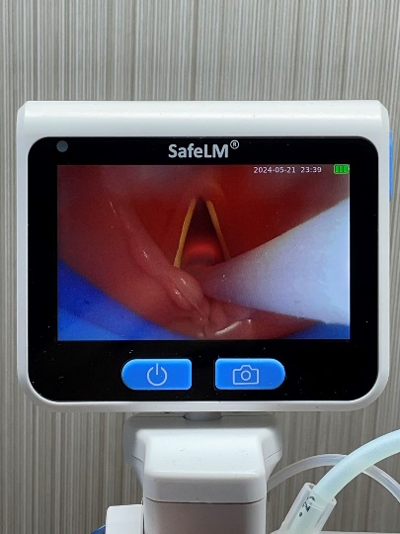
Unique Benefits of SafeLM in Eye Surgery
Video guidance ensures a smoother insertion, minimizing patient movement and hemodynamic fluctuations which impact ocular structures and pressures
Reduced airway trauma and complications for faster recovery
Continuous monitoring throughout the surgery for regurgitation/secretions
Supports easier extubation compared to ETT, less coughing
Reducing unnecessary intubations, drug use and complications to improve operating room efficiency, for more cases per day
Gentle guided suction

Slide 9
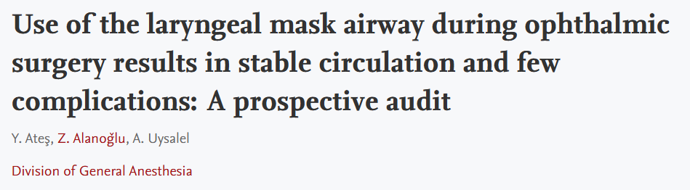
Clinical Evidence
Background: This study was performed to investigate airway complications related to Laryngeal Mask Airway (LMA) use in a selected group of paediatric patients undergoing ophthalmic surgery. Methods: Ninety-four paediatric patients were enrolled. LMA was inserted under deep general anaesthesia with the standard technique previously described by Brain. Complications during induction, insertion of the LMA, maintenance of anaesthesia, removal of the LMA, emergence and on the first postoperative day were recorded. Failure of insertion, desaturation, laryngospasm, bronchospasm, vomiting, bucking, dislocation of the LMA, breath-holding, and coughing were noted.
Results: There was no significant age-related difference in successful insertion ratio of the LMA. In two patients (2%), the LMA could not be inserted with three attempts and tracheal intubation was performed. Laryngospasm was recorded in three patients (3%), leading to desaturation in two patients (SaO₂<95%) during insertion of the LMA. During maintenance of anaesthesia bucking occurred in one patient (1%). After removal of the LMA, incidence of early desaturation following upper airway suctioning was higher in patients with a history of frequent upper respiratory tract infection (P<0.01). Five patients (5%) had laryngospasm following the LMA removal; breath-holding and coughing were noted in 21 (22%) patients. Circulatory reactions to insertion and removal of the LMA were minimal. The incidence of sore throat on the first postoperative day was only 1%.
Conclusion: LMA can be regarded as a safe product for airway maintenance during ophthalmic surgery with a stable circulation and few complications.
Ateş, Y., Alanoǧlu, Z., & Uysalel, A. (1998). Use of the laryngeal mask airway during ophthalmic surgery results in stable circulation and few complications: A prospective audit. Acta Anaesthesiologica Scandinavica, 42(10), 1180-1183. https://doi.org/10.1111/j.1399-6576.1998.tb05273.x

Slide 10
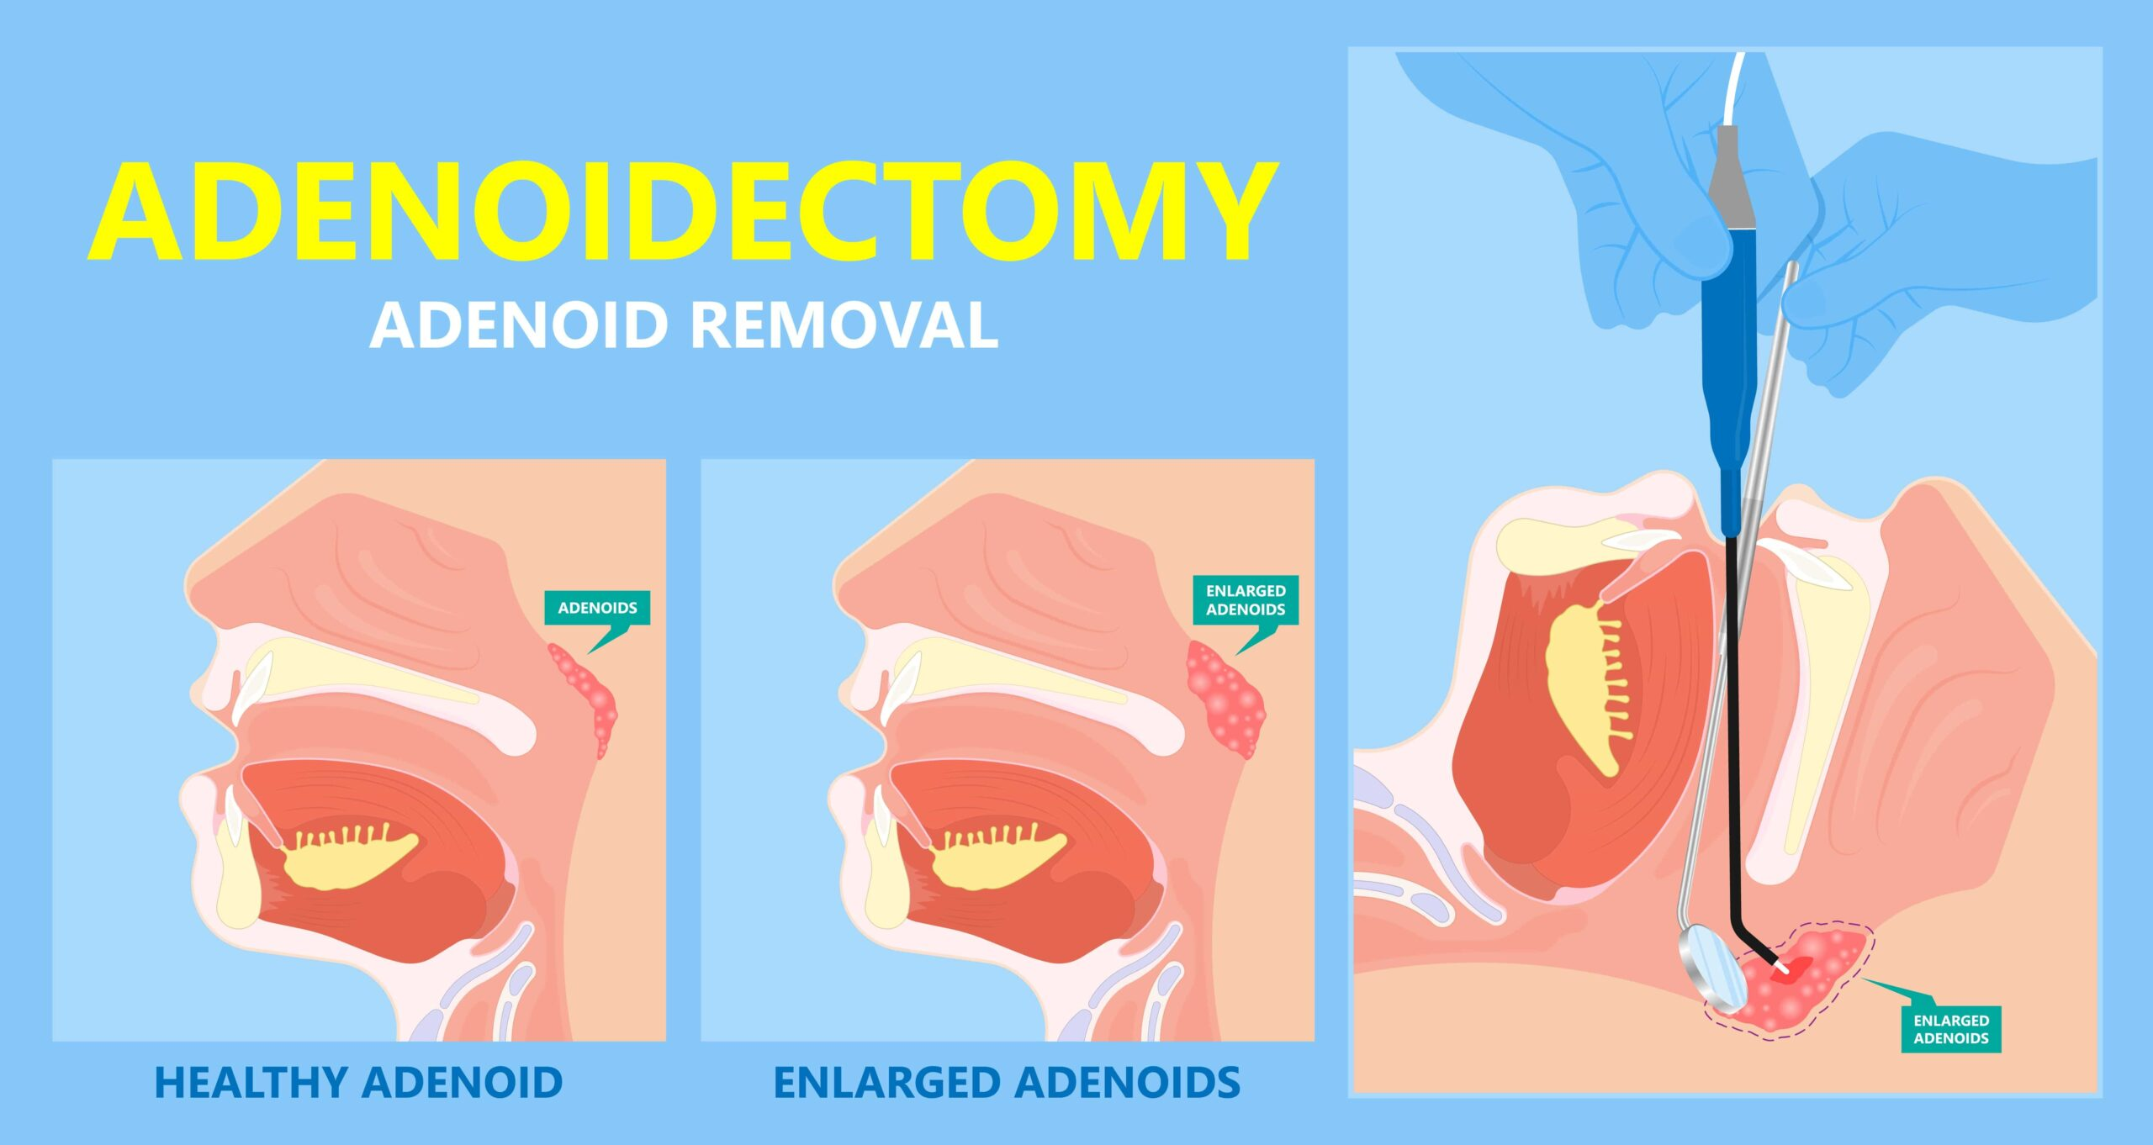
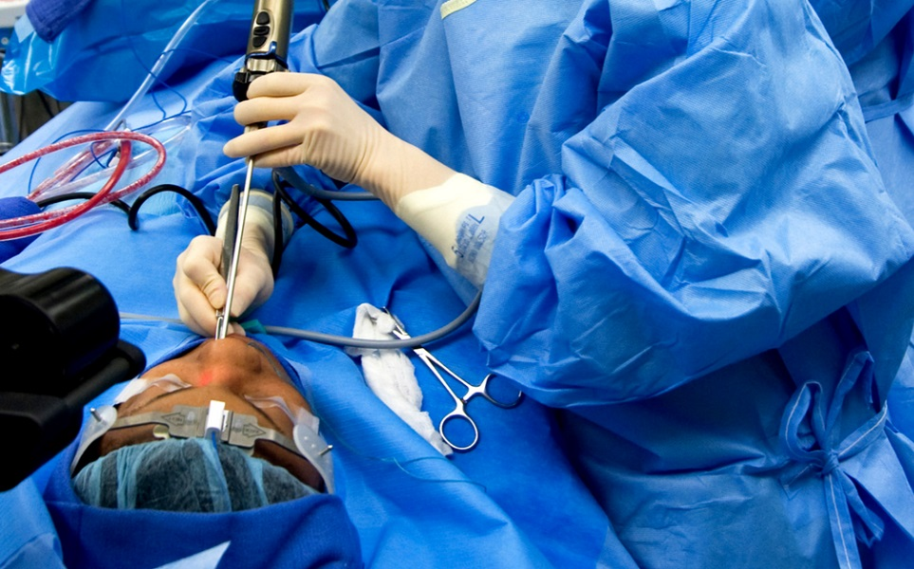
ENT Airway Management Considerations
Shared airway
Many ENT procedures (laryngeal surgery, bronchoscopy, tonsillectomy) involve the airway directly.
Difficult airway risk
Tumors, infections, trauma, or congenital anomalies can distort anatomy.
Awake fiberoptic intubation, video laryngoscopy, or tracheostomy may be necessary.
Aspiration risk
ENT patients often present with bleeding, secretions, or obstructive masses.
Positioning and access
Surgical drapes limit anesthesiologist’s access to airway.
Tube fixation and secure connections are critical.
Emergence considerations
Smooth extubation is essential to avoid coughing, bleeding, or airway edema.
Postoperative airway obstruction risk is high (tonsillectomy, thyroidectomy, laryngeal surgery).

Slide 11
Benefits and Barriers of SGA Use in ENT Surgery
Benefits
Barriers
Reduced hemodynamic stress compared with endotracheal intubation
Superior emergence characteristics both in terms of respiratory and cardiovascular profiles (ENT has high incidence of airway problems in recovery)
Reduced incidence of coughing, bucking and straining
Lower rates of bronchospasm, desaturation, hoarse voice
Reduced post-operative complications
Facilitates spontaneous ventilation
Risk of aspiration of stomach contents
Brimacombe study had no episodes of aspiration with 1500 uses (1996)
Protection against soiling from the surgical site with blood and debris
FLMA found to be equivalent to cuffed ETTs in protecting from aspiration of blood (Sierpina, 2012)
Displacement with head movement, risk of air leak
Suitability for prolonged surgery
Cases requiring tight control of ventilation

Slide 12
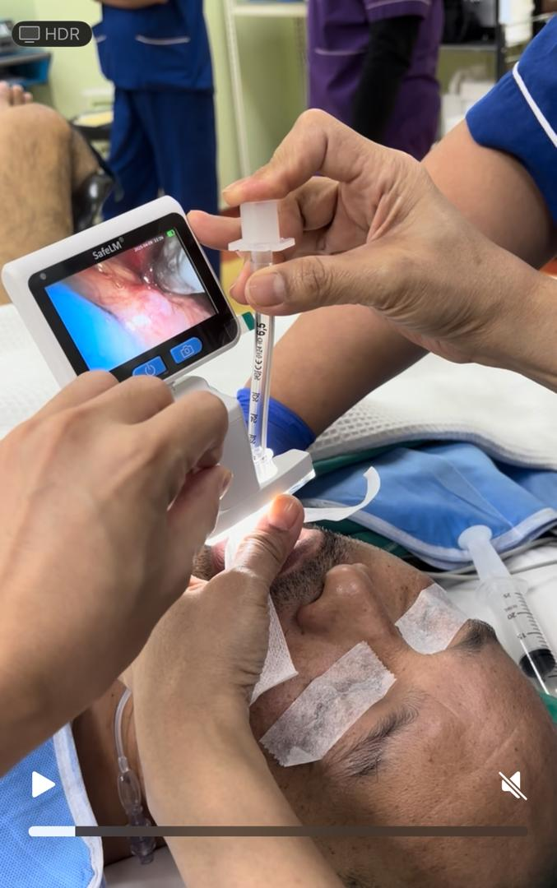
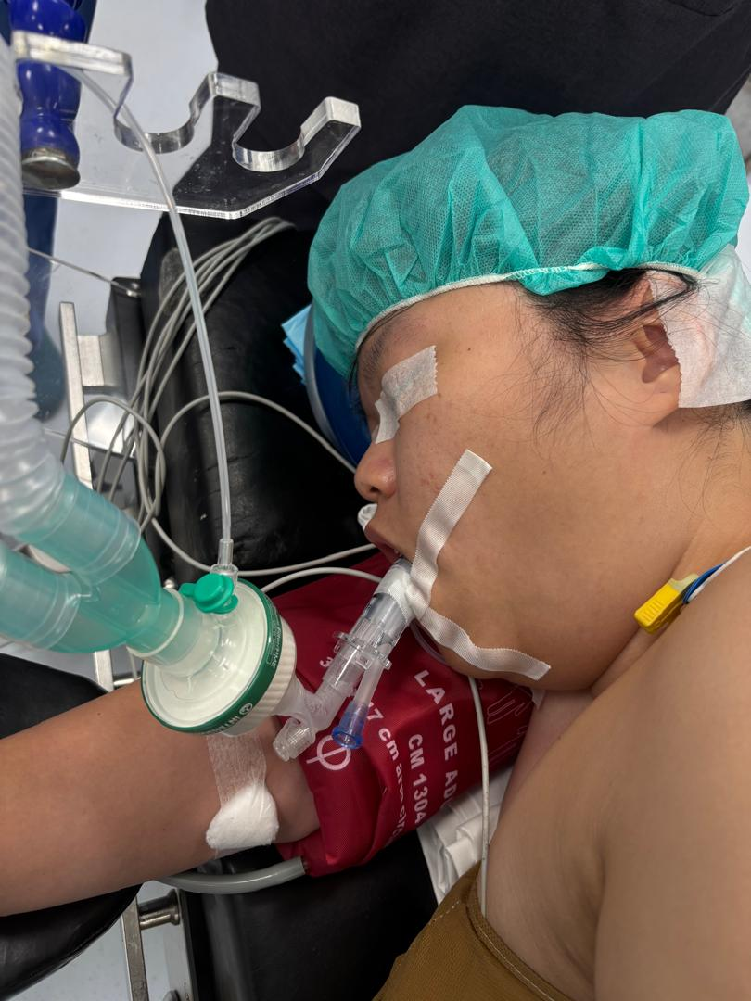
Benefits of SafeLM in ENT Surgery
Support high OLP (35-40cm H2O) because of high fit between laryngeal mask and larynx
Continuously monitor the airway to prevent the blood flowing in the throat from entering the airway
Maintain correct positioning even with head movement
Quickly convert to ETT without interfering with the surgery

Slide 13
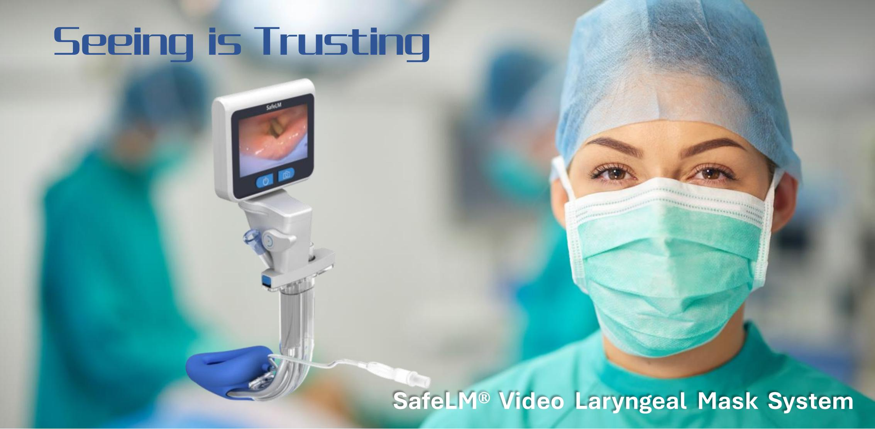
Changsha Magill Medical Technology Co. Ltd.
Notes:
SafeLM is a smarter, safer, and more efficient evolution of LMA. By video guidance it overcomes limitation of traditional blind insertion, also increases the Dr’s confidence in placing LMA, minimizing airway trauma and most importantly-enhance patient safety.

