Slide 1

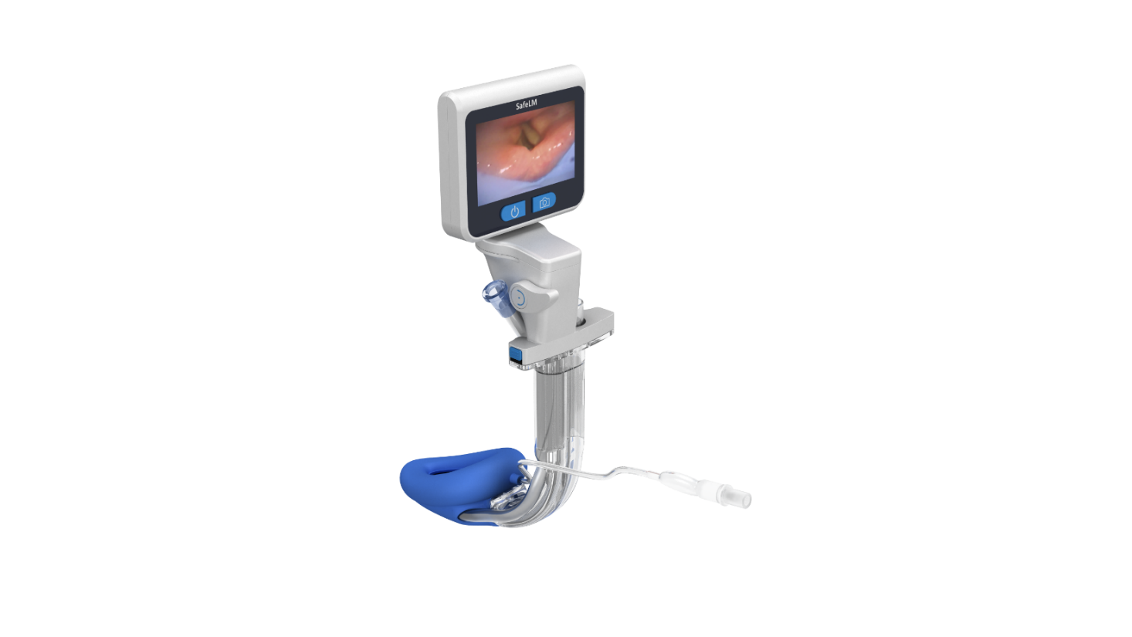
Magill Medical Technology
Innovation for Better Health
Importance of SGA Visualization
Confidential

Slide 2
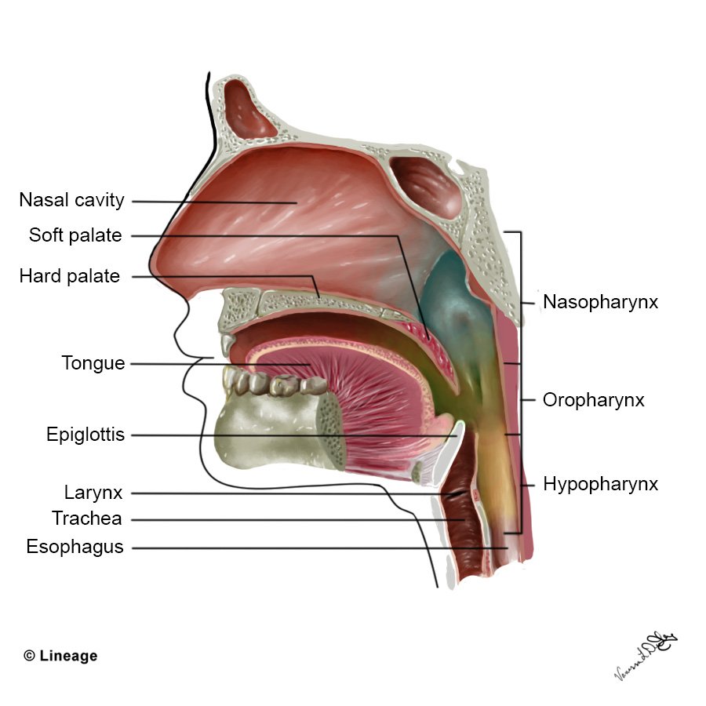
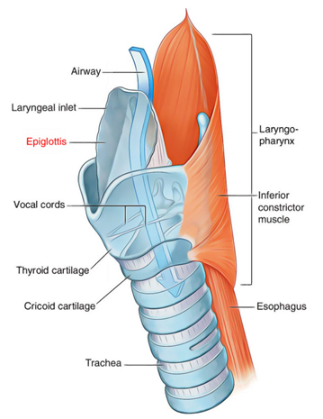
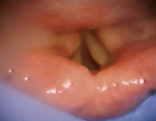
Airway basics – the pharynx
Hypopharynx (Laryngopharynx)
Location: From the epiglottis to the cricoid cartilage
Functions:
Directs food to the esophagus
Air is diverted into the larynx and trachea
Critical in airway protection via epiglottis and laryngeal reflexes

Slide 3
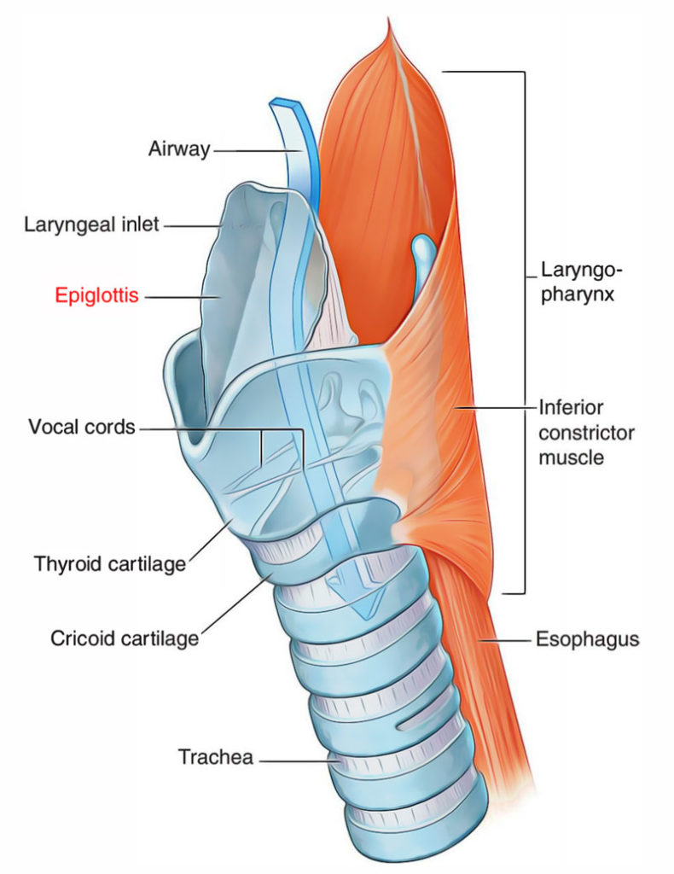
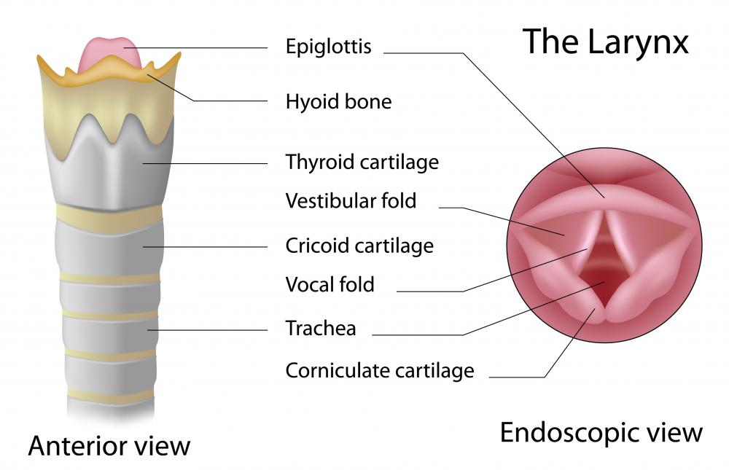
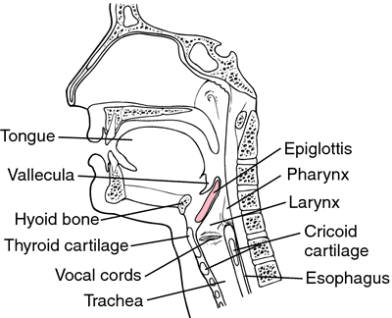
Airway basics – the glottis
(Arytenoid cartilage)
The epiglottis
A leaf-shaped flap of elastic cartilage located at the entrance of the larynx.
Protects the airway
Coordinates swallowing
Supports airway patency (resting)
The glottis
The part of the larynx that includes the vocal cords and the space between them (rima glottidis).
Controls air entry into the trachea and lungs
Phonation
Airway protection during swallowing (vocal cords adduct)
Cough reflex

Slide 4
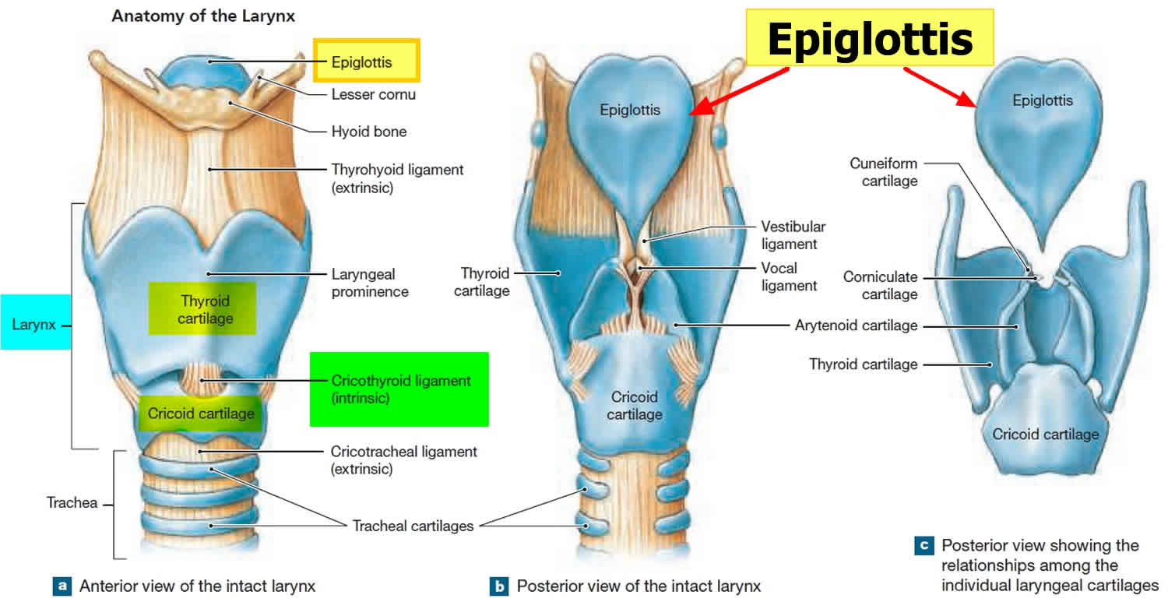

Slide 5
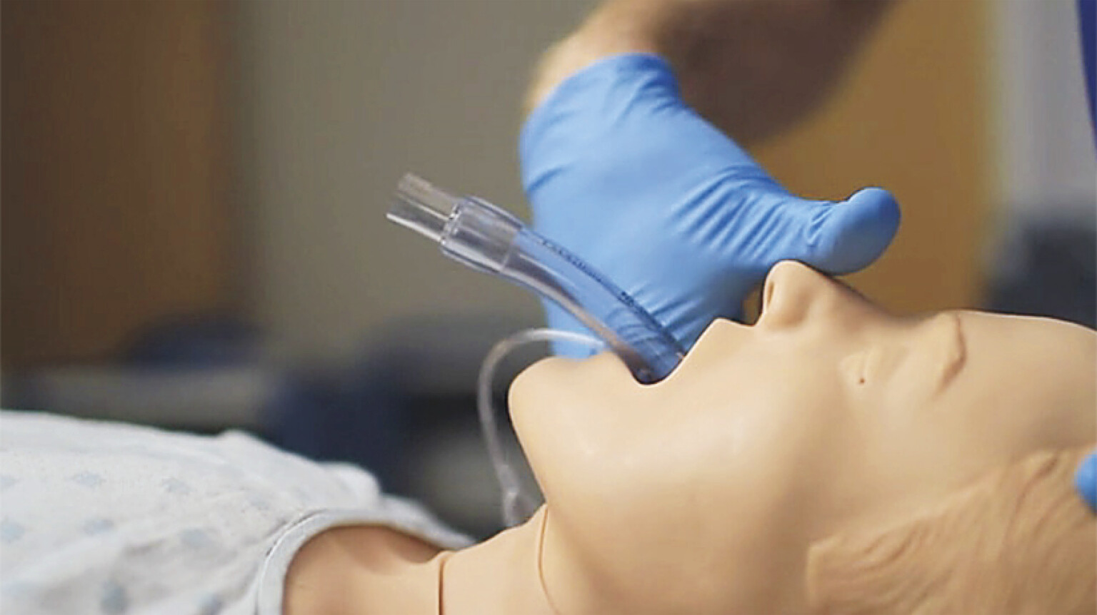
Why is visualised SGA insertion important?
Many can insert SGA successfully
Few can place it successfully
Insertion refers to simply getting the device into the mouth and advancing it into the hypopharynx. Many clinicians can achieve this without much difficulty.
Ideal placement however, means that the device is positioned correctly to create an effective seal, provide unobstructed ventilation, and allow for adequate oxygenation and ventilation.

Slide 6
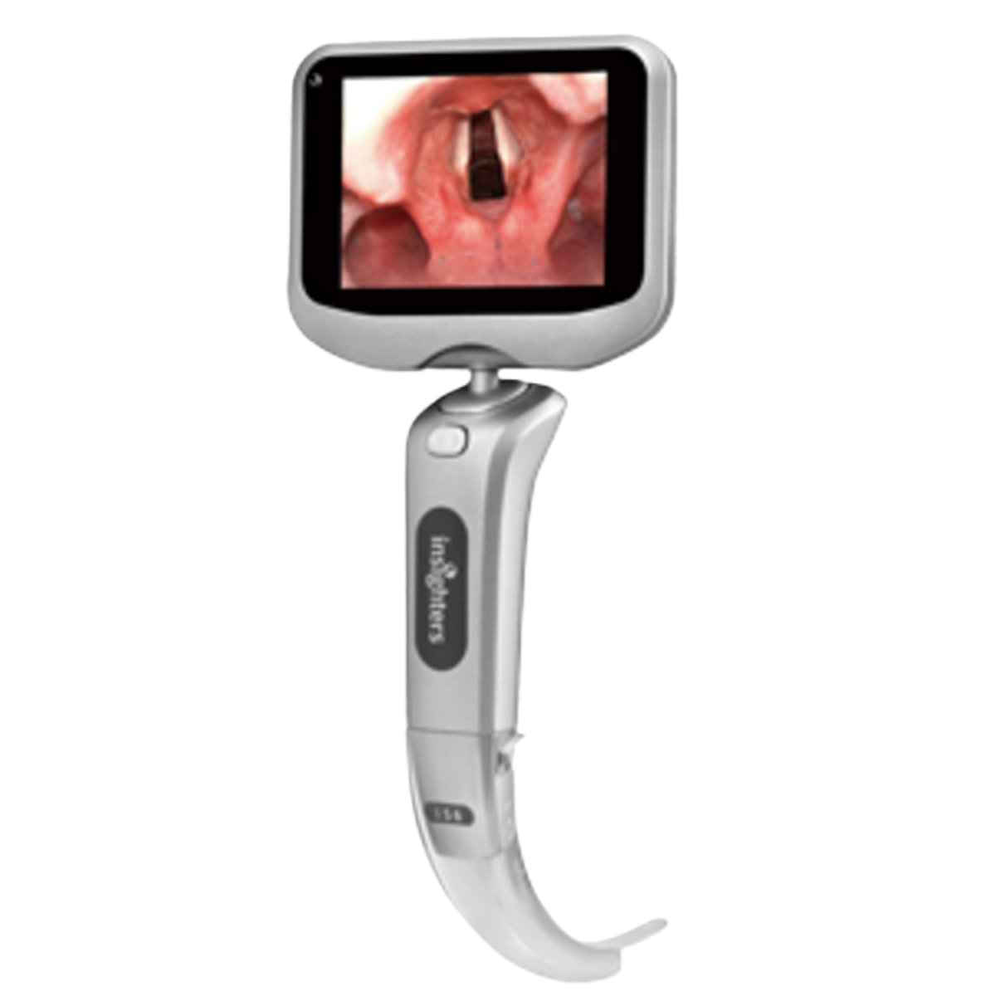
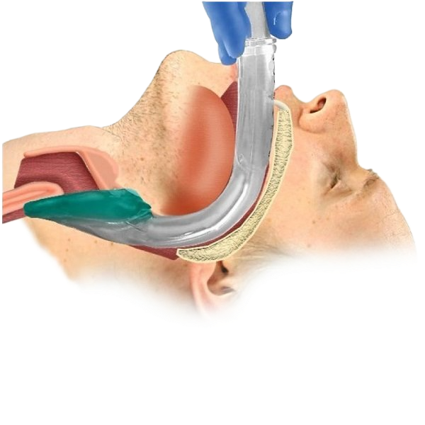
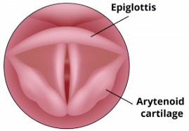
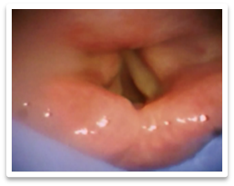
Why the Paradox?
Contrary to the insertion of ETT, which is guided to the trachea under direct vision of a direct/video laryngoscope.
But the SGA is virtually a ‘blind’ technique, whereby relies on the practitioner’s skills to insert it into hypopharynx.

Slide 7
Why is blind placement suboptimal?
Anatomical variations – Unusual airway structures, obesity, or limited mouth opening may complicate placement.
Operator experience – Subtle adjustments (depth, angle, cuff inflation) relies on experience and instinct.
Malposition – The SGA tip may fold or sit incorrectly, leading to airway obstruction or ineffective ventilation.

Slide 8
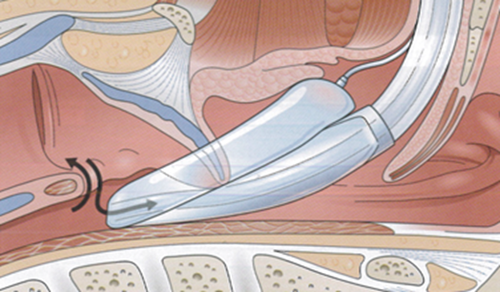
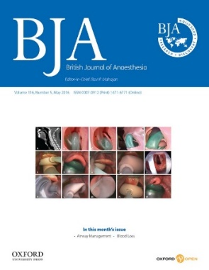
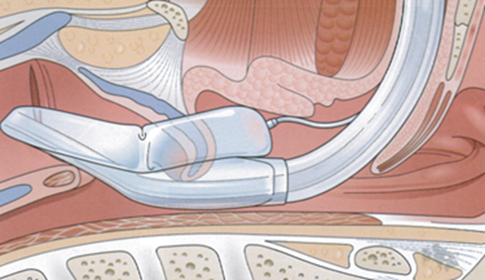
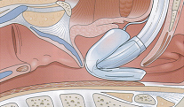
Malposition - Outcomes of blind SGA placement
Study showed Malposition occurs in 50% to 80% of blind placement ！
Insufficient Depth
Glottic Placement
Mask or tip fold over
1. A. A. J. Van Zundert, Malpositioning of supraglottic airway devices: preventive and corrective strategies British Journal of Anesthesia 116 (5): 579–82 (2016)

Slide 9
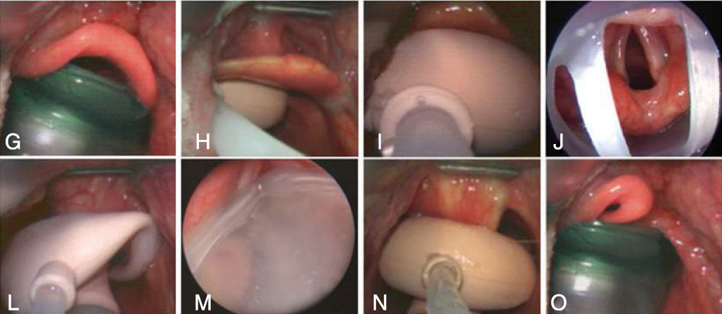
Malposition - Outcomes of blind SGA placement

Slide 10
Consequences of a malpositioned SGA
Air leak – results when an SGA is not ideally placed and results in an inadequate seal, this can happen at any time during surgery
Airway obstruction – commonly due to downfolding of the epiglottis or when the tip of the mask is folded over
Airway trauma – blindly inserting the SGA can cause injury to airway soft tissues
Regurgitation/Aspiration – a poorly sealed SGA increases the risk of gastric insufflation, abdominal distension, regurgitation, and subsequent aspiration.

Slide 11
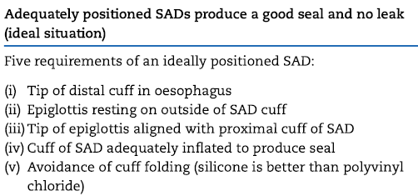
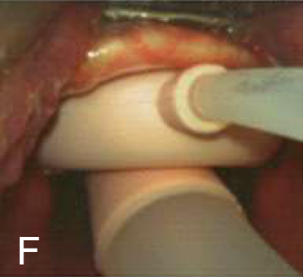
Ideal position of SGA

Slide 12

Benefits of Visualised SGA insertion
Solution to visualise SGA insertion - > SafeLM 3rd Gen. SGA
Benefits
Successful first attempt SGA placement
Reduced consequences of malpositioned SGA
Higher oropharyngeal leak pressure
Monitor airway for secretion/regurgitation content
Visualised and guided ETT insertion if needed

Slide 13
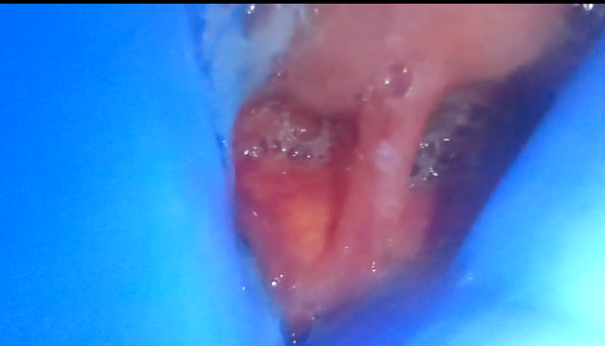
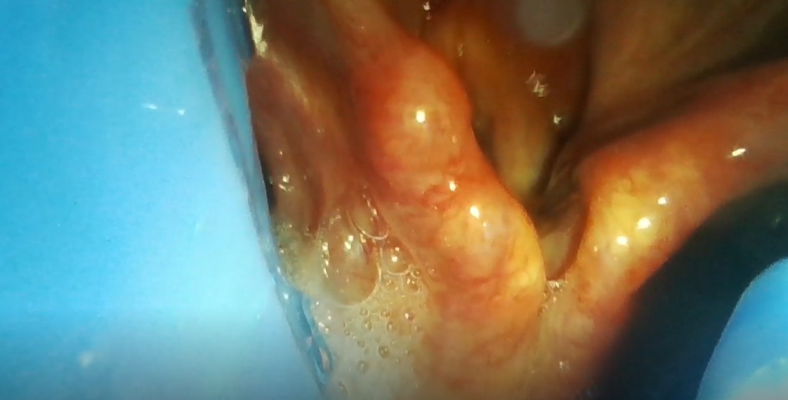
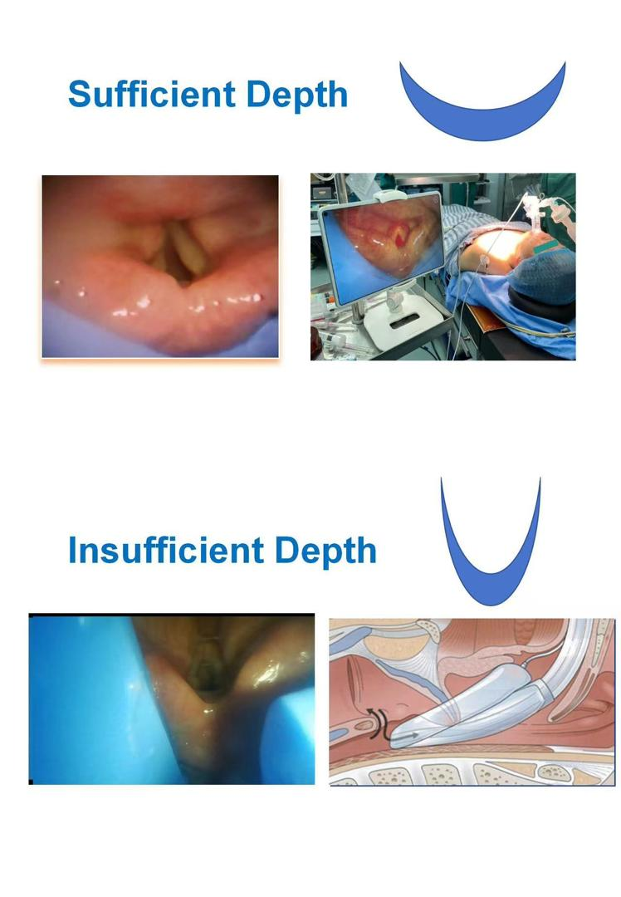
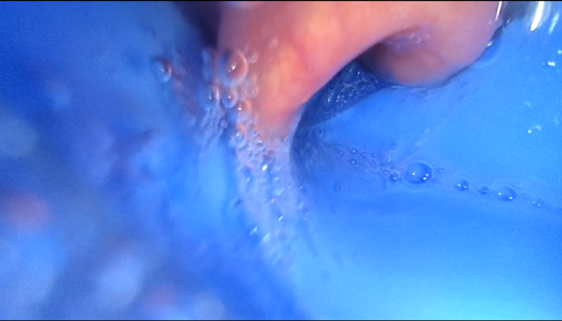
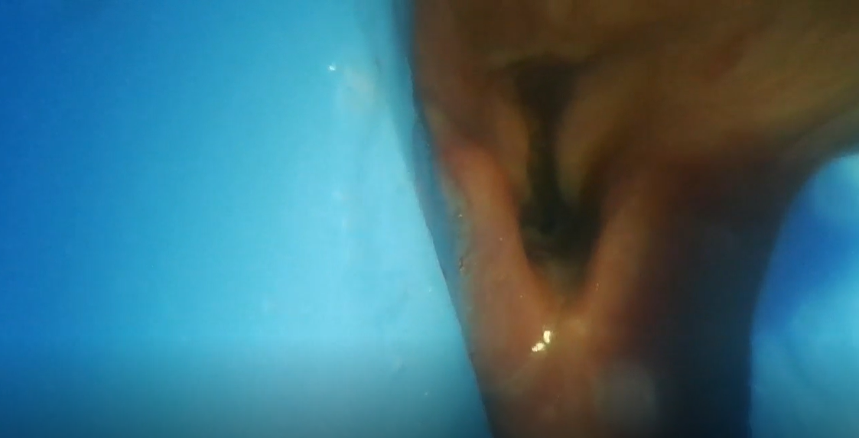
Case reviews
Epiglottis downfolded
Too deep
Epiglottis stuck inside cuff
Insufficient depth

Slide 14
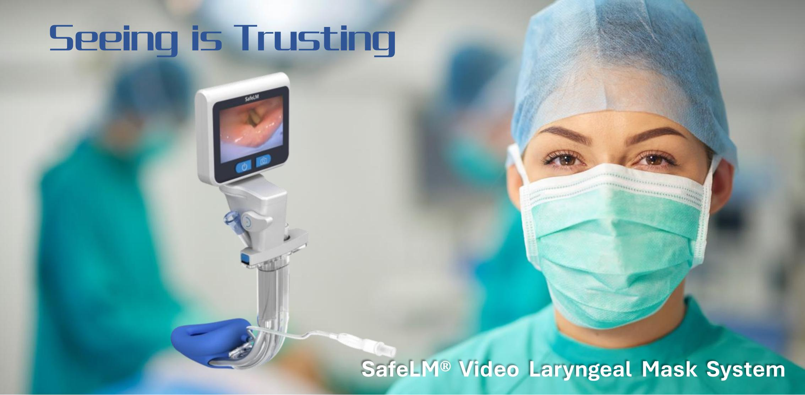
Changsha Magill Medical Technology Co. Ltd.

